Slide 1
Design of an IoT-enabled Scalable Closed Hydroponics System with Smart Parameter Control
Supervised by:
Dr. Lafifa Jamal Professor Department of Robotics and Mechatronics Engineering University of Dhaka
Proposed by: Mikdam-Al-Maad Ronoue Class Roll: FH-092-003 MD. Sameer Iqbal Chowdhury Class Roll: SH-092-002

Slide 2
Methodology

Slide 3
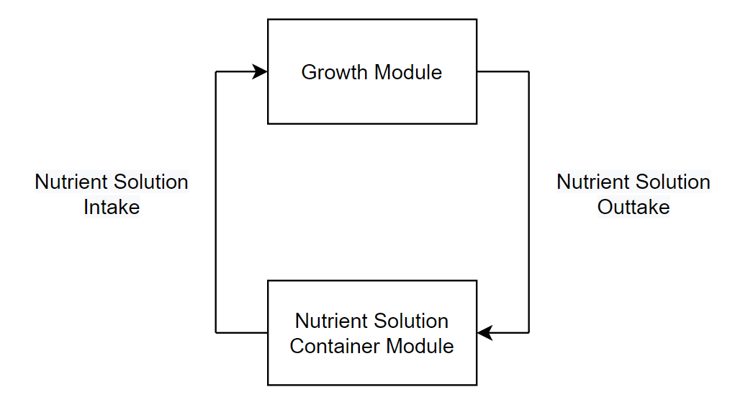
Overview
Fig. 1: Simplified outline of the system illustrating the flow of nutrient solution

Slide 4

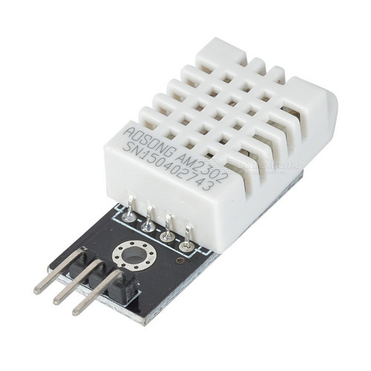
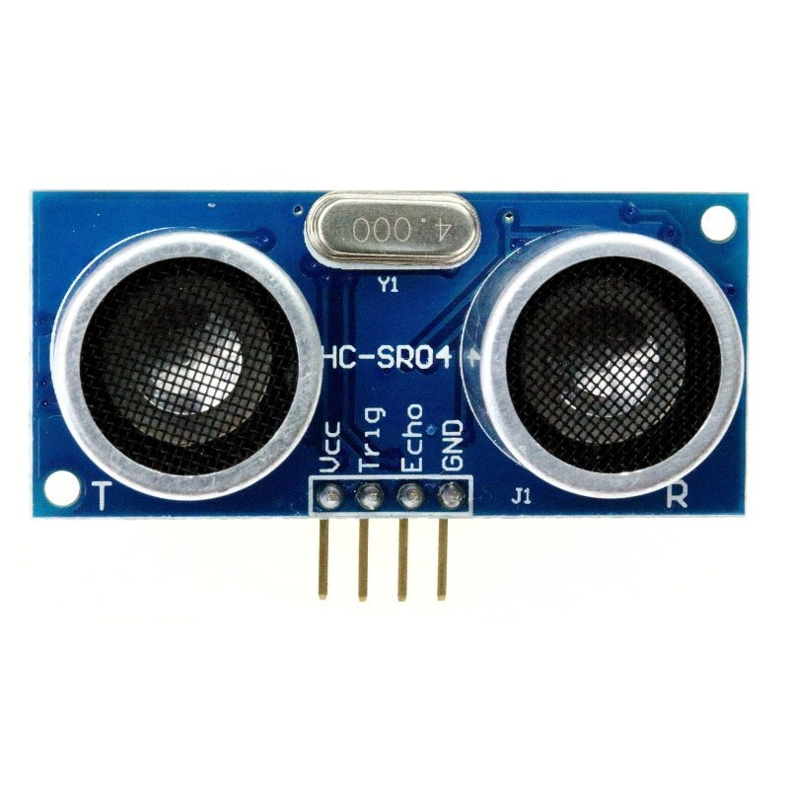
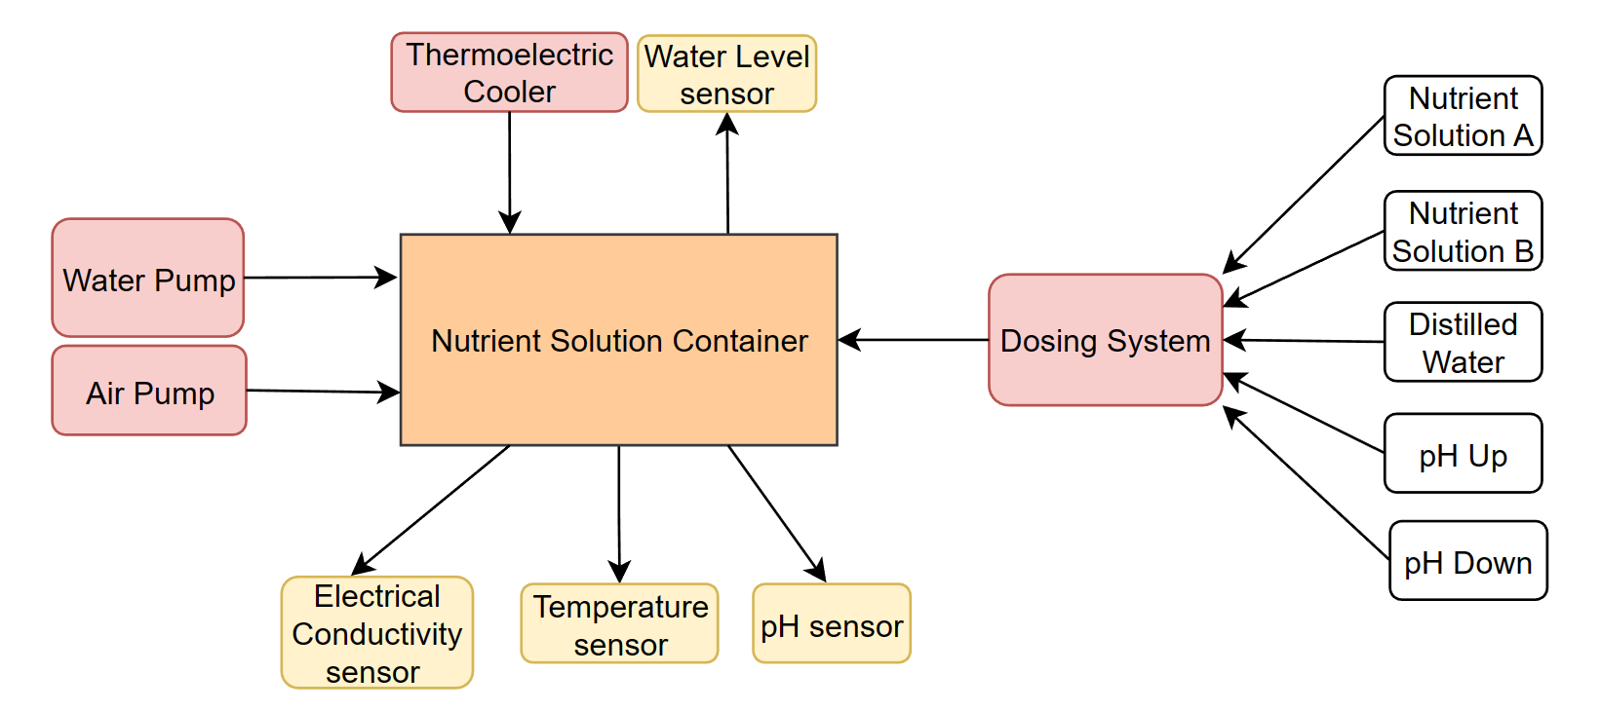
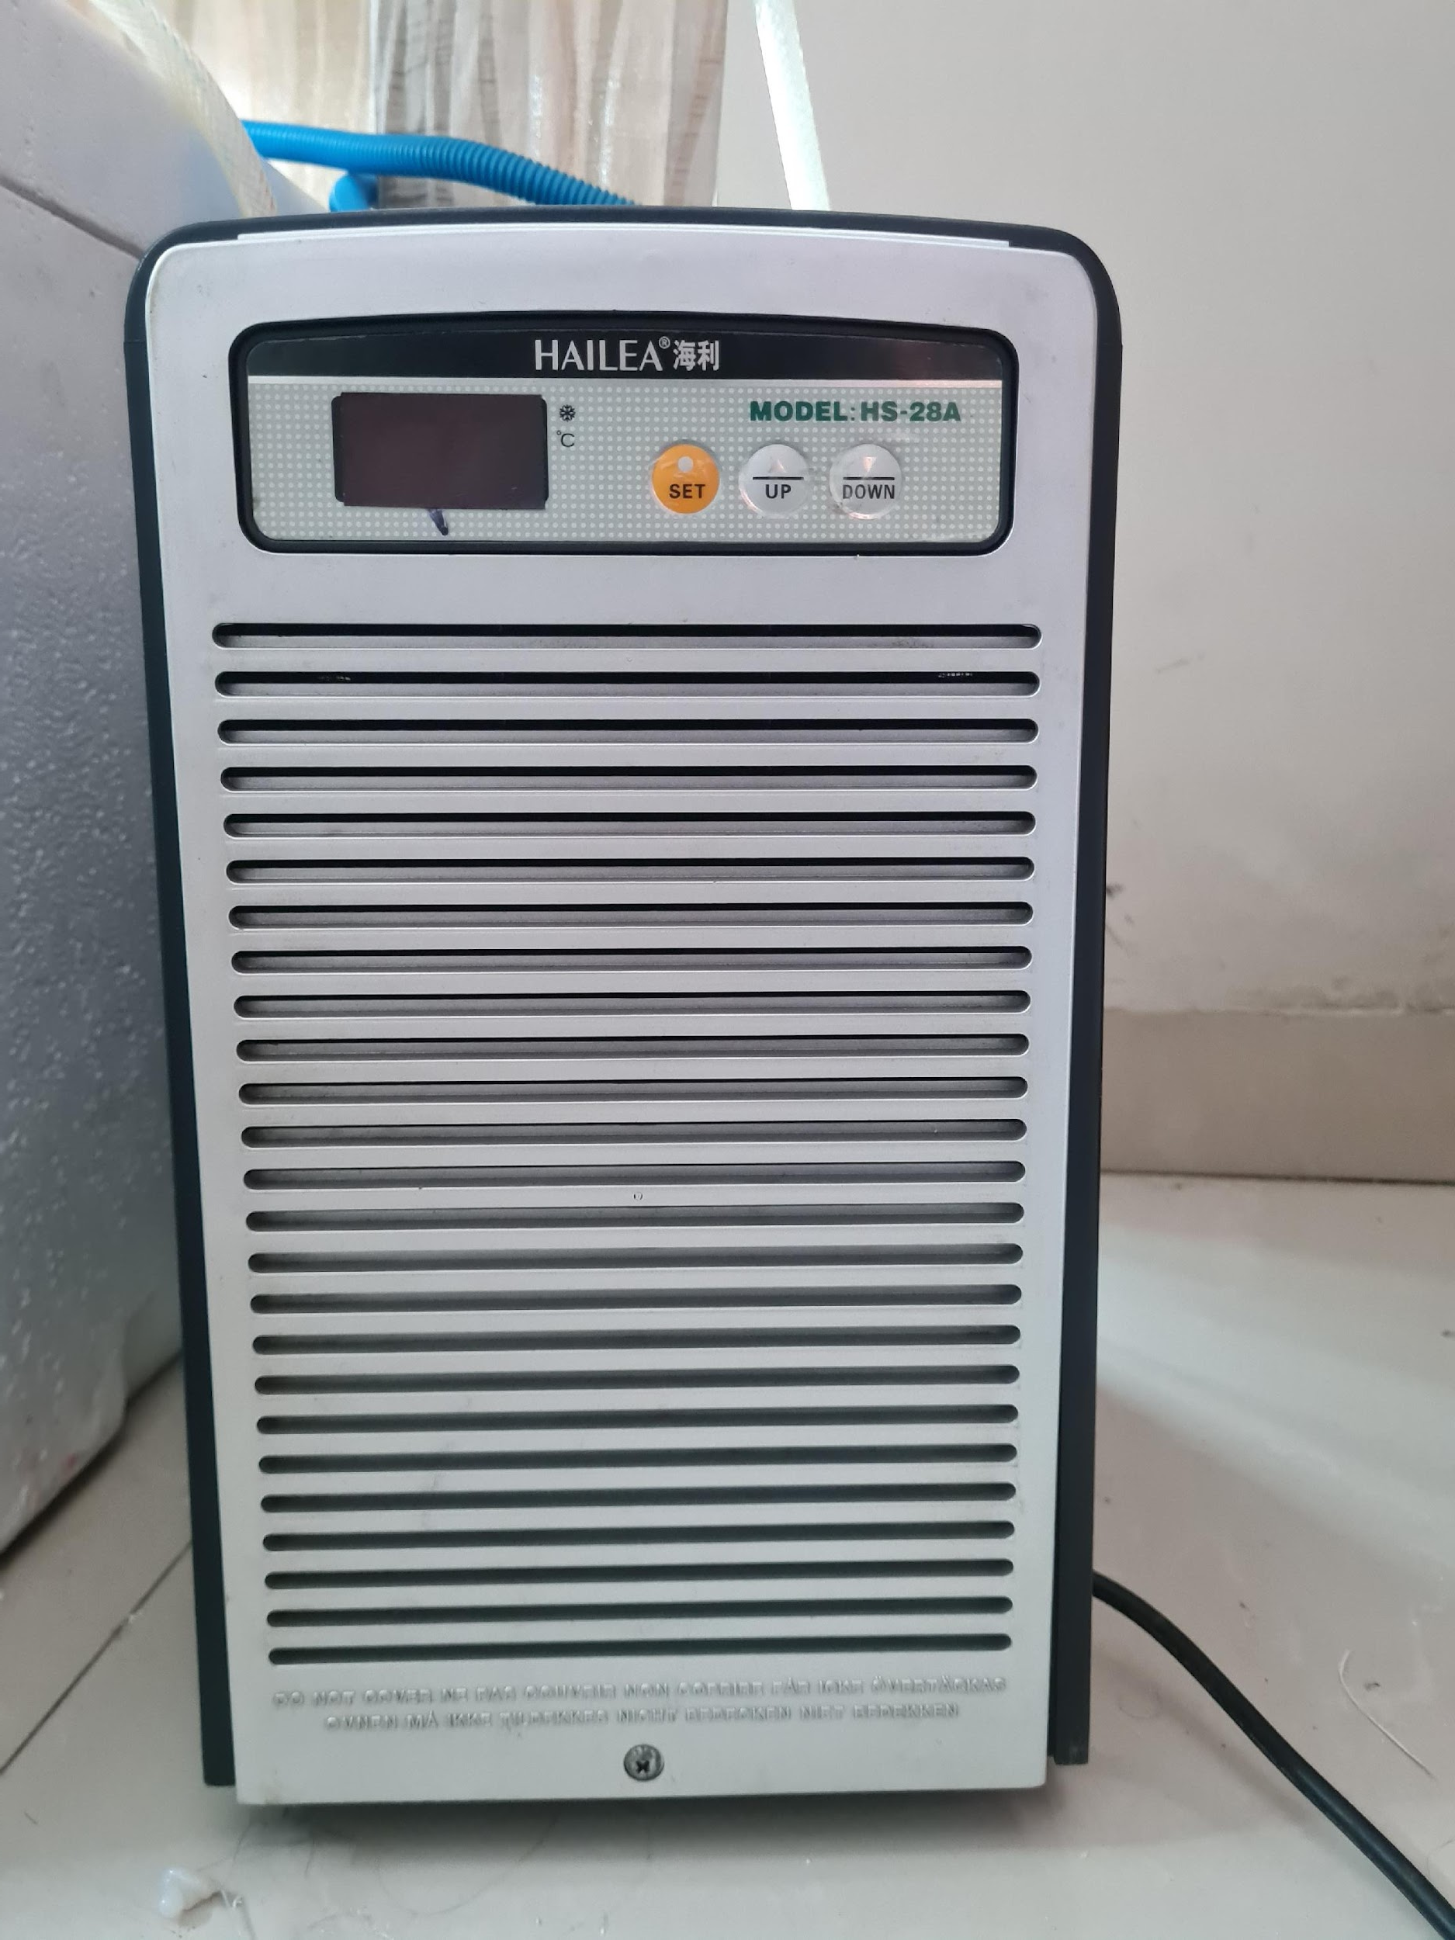
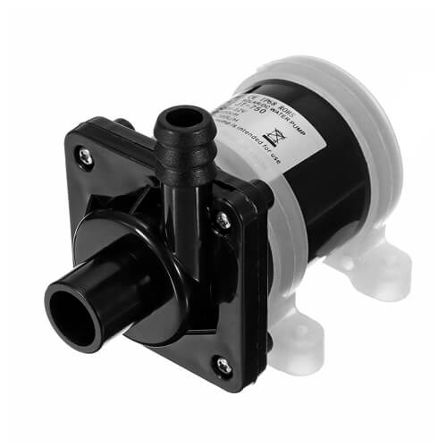
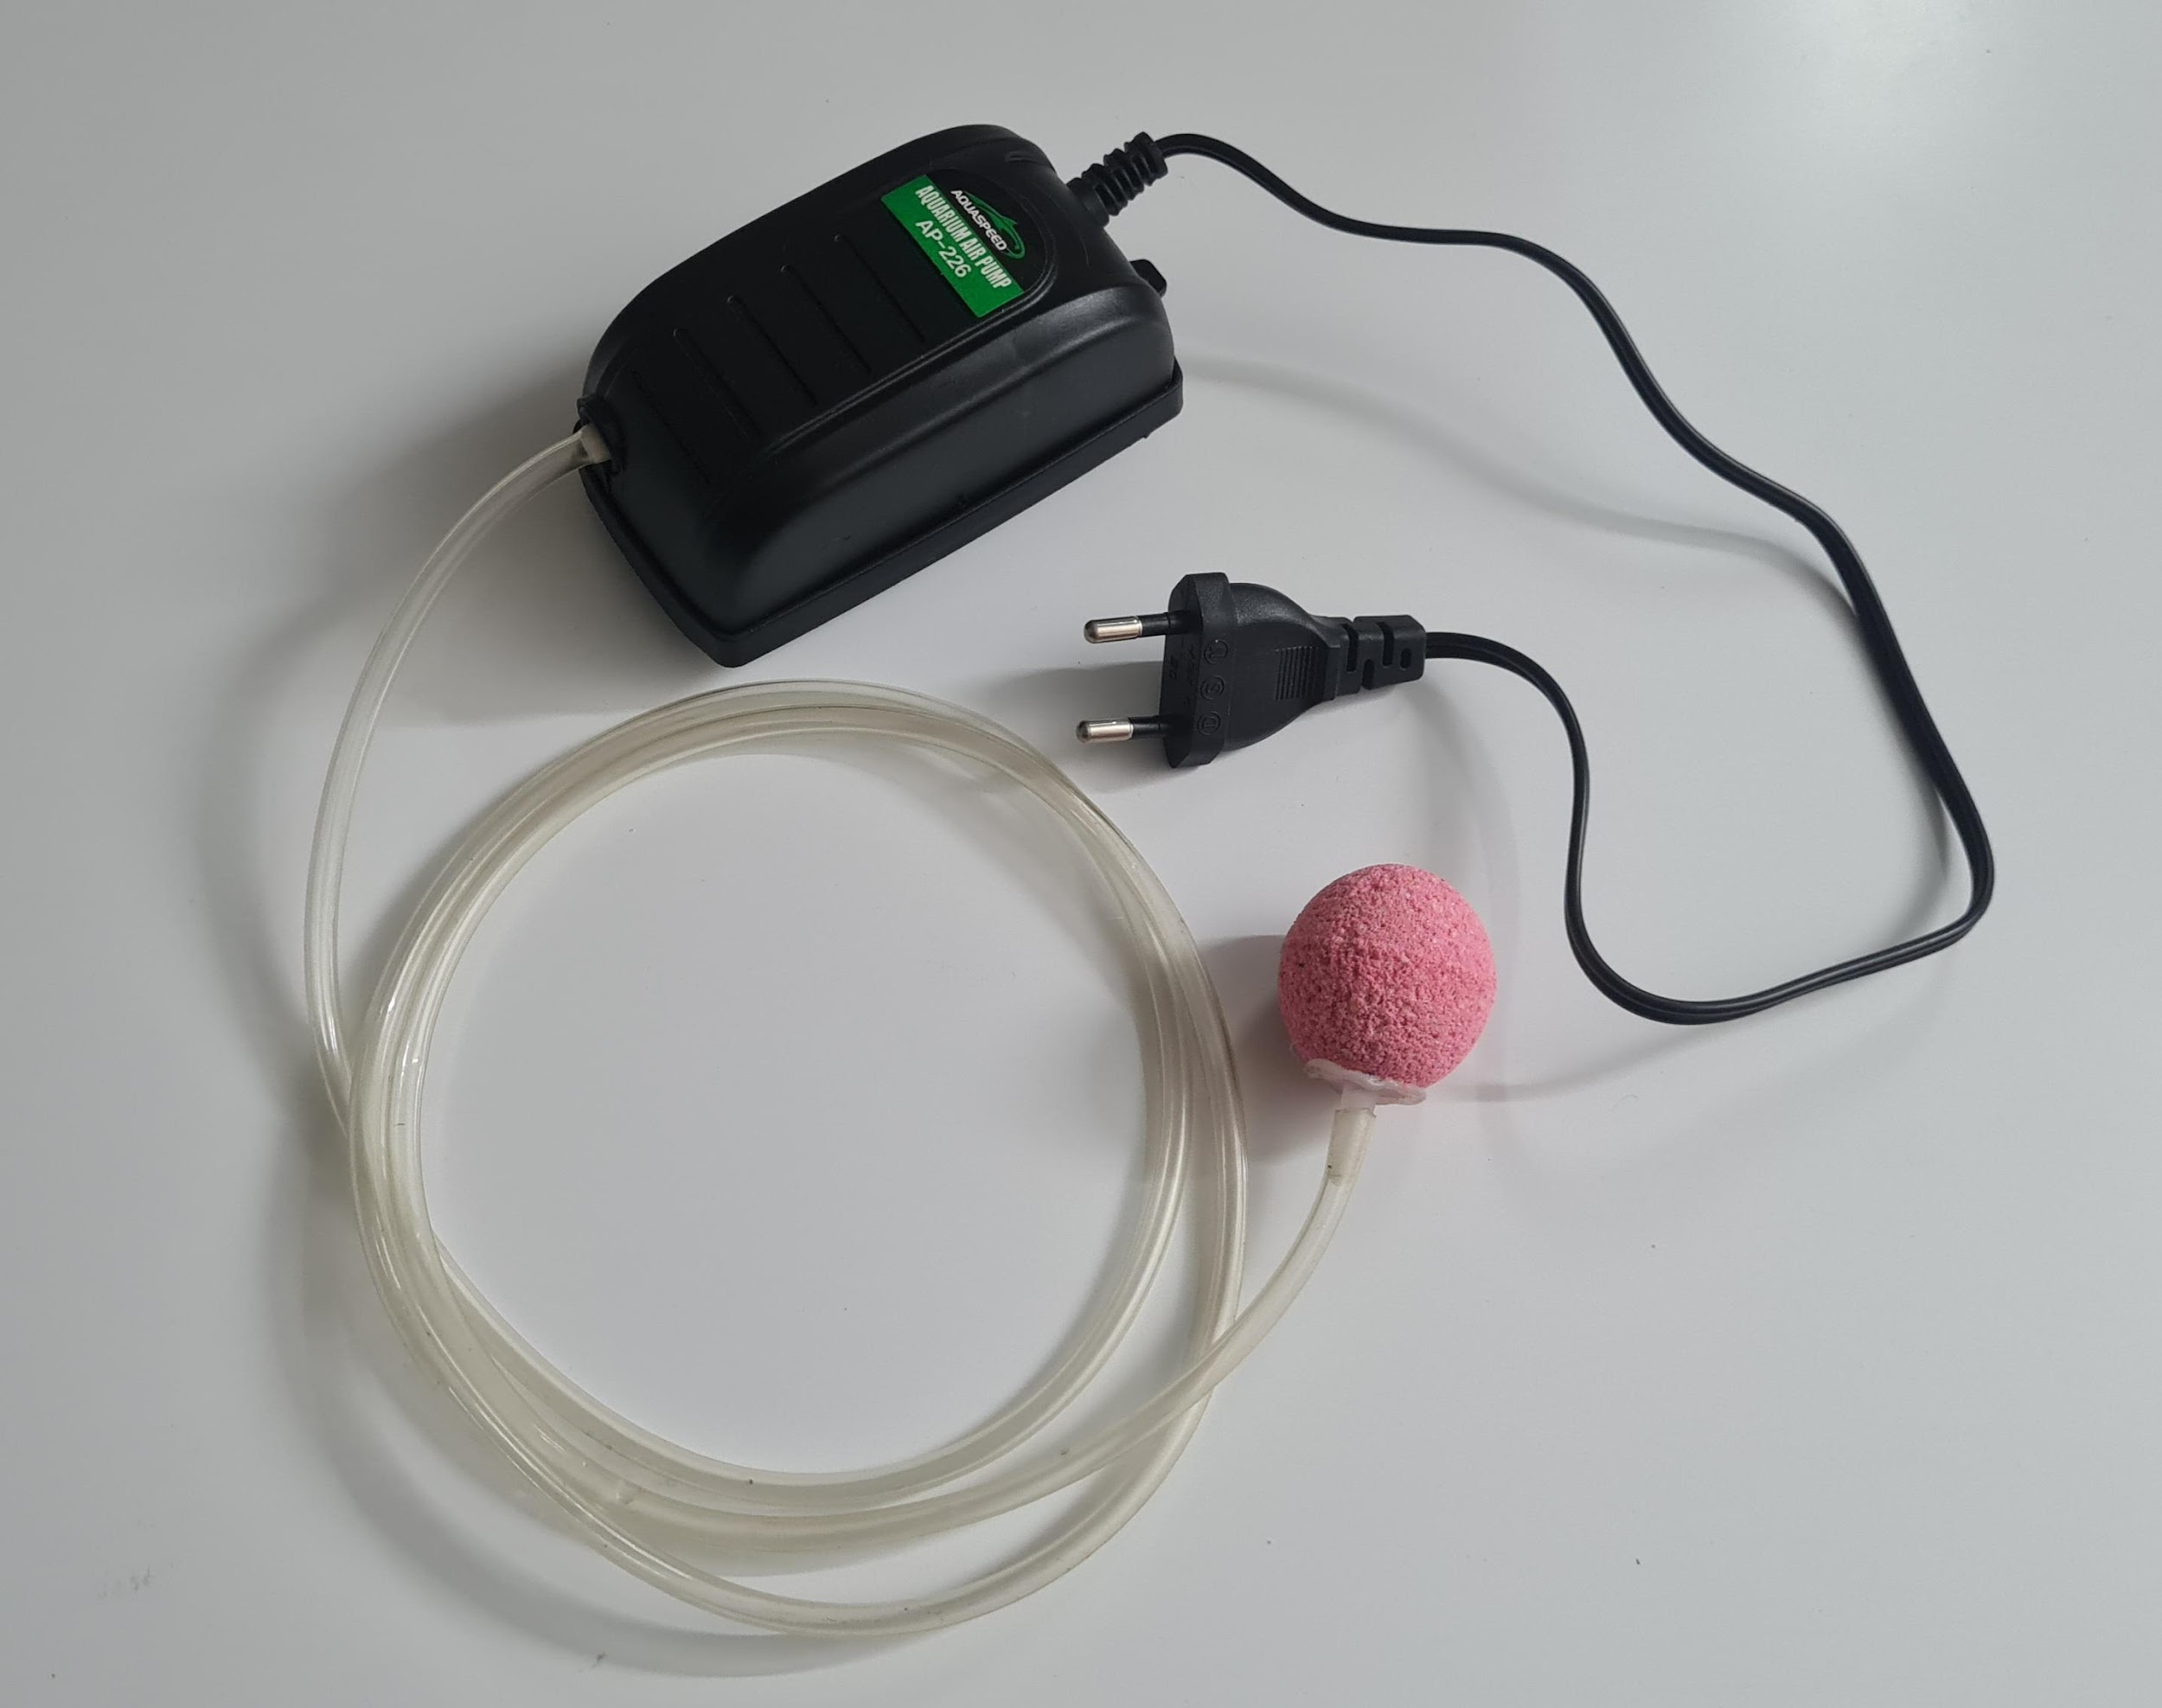
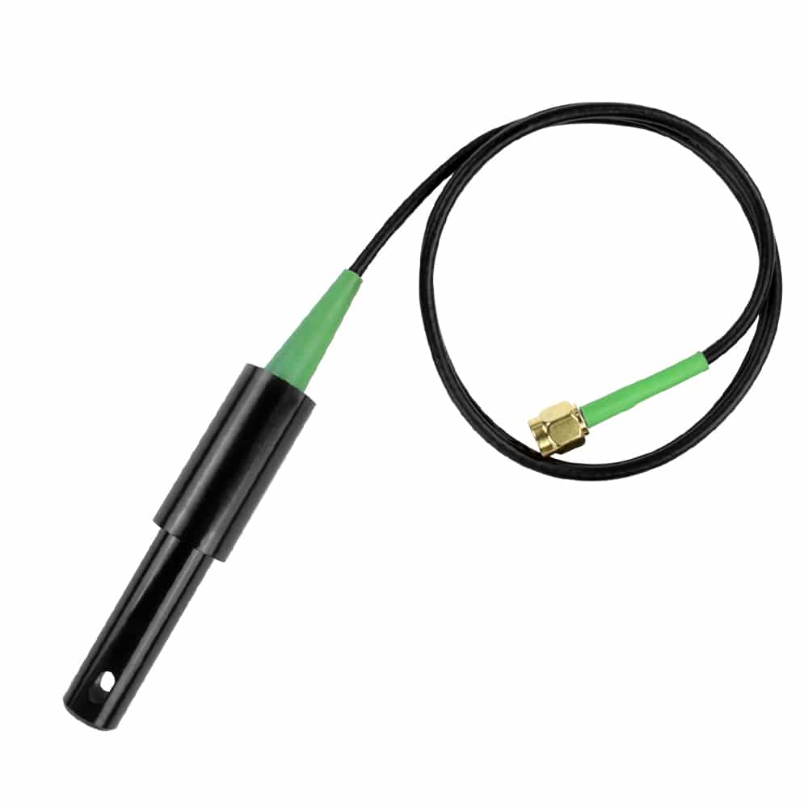
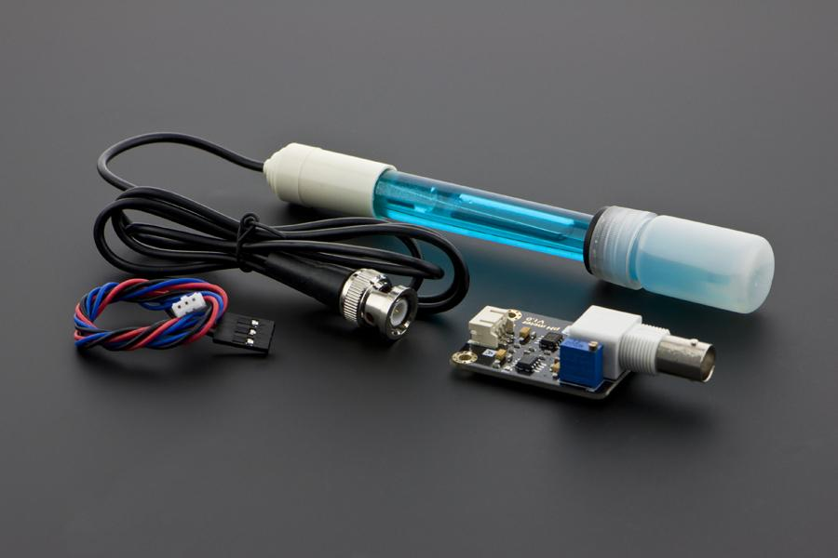
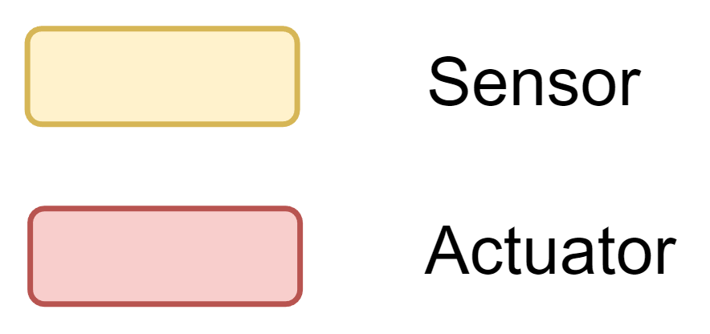
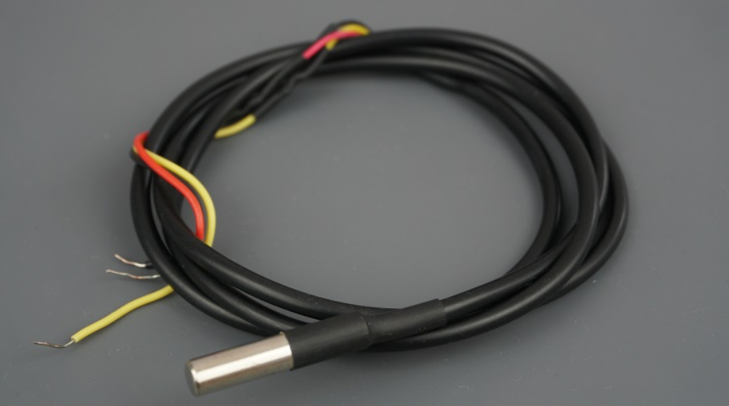
Nutrient Solution Container Module
Fig. 2: Block diagram for communication between microcontrollers and the central server

Slide 5
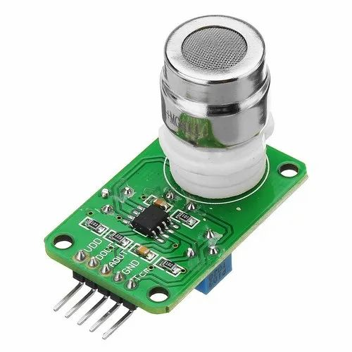
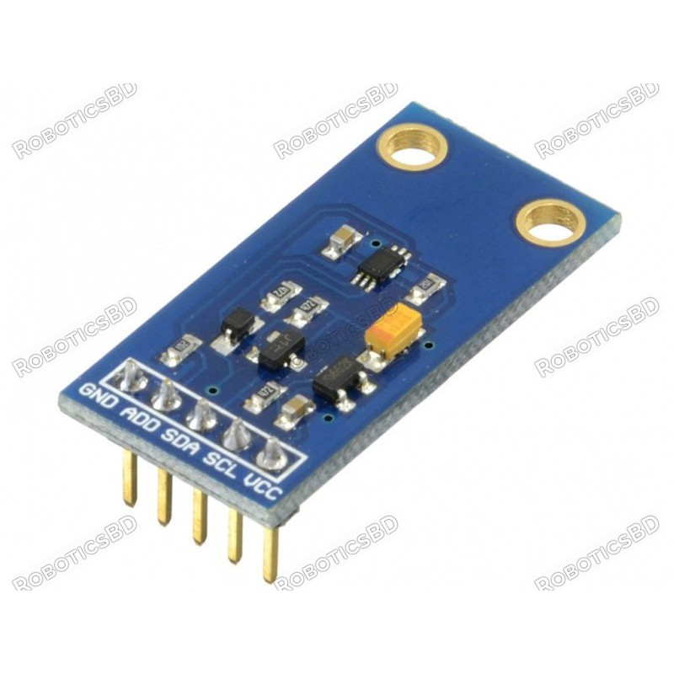
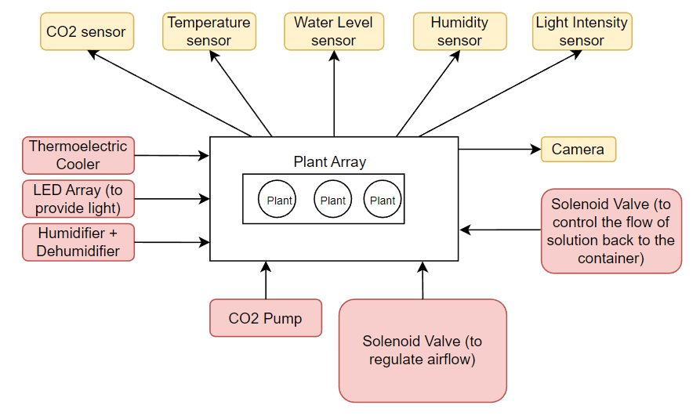
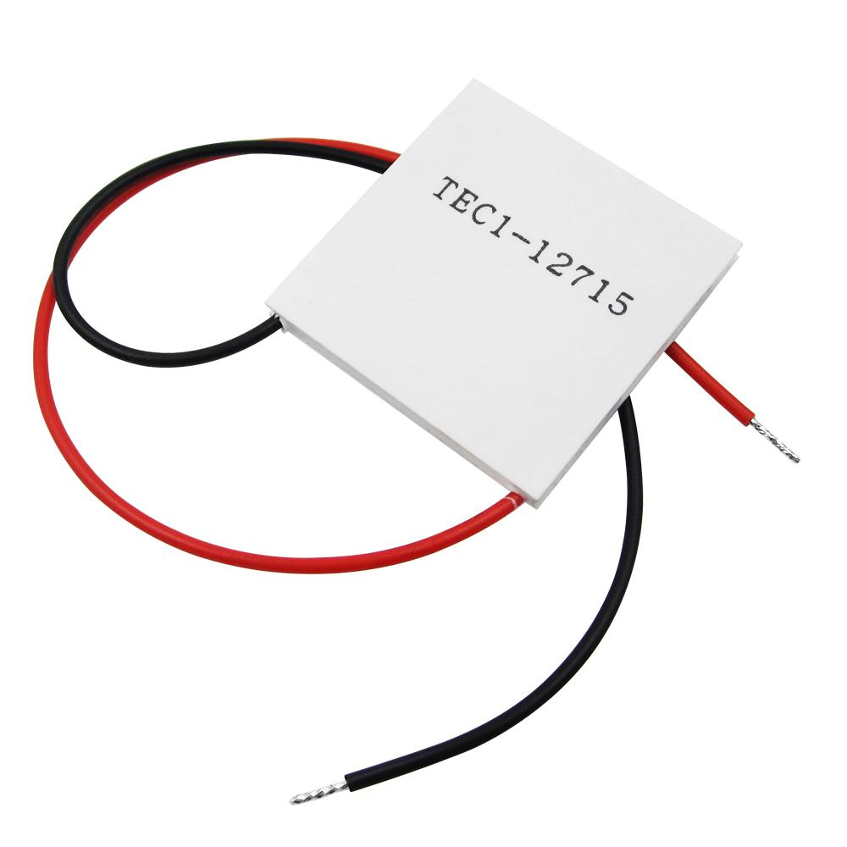
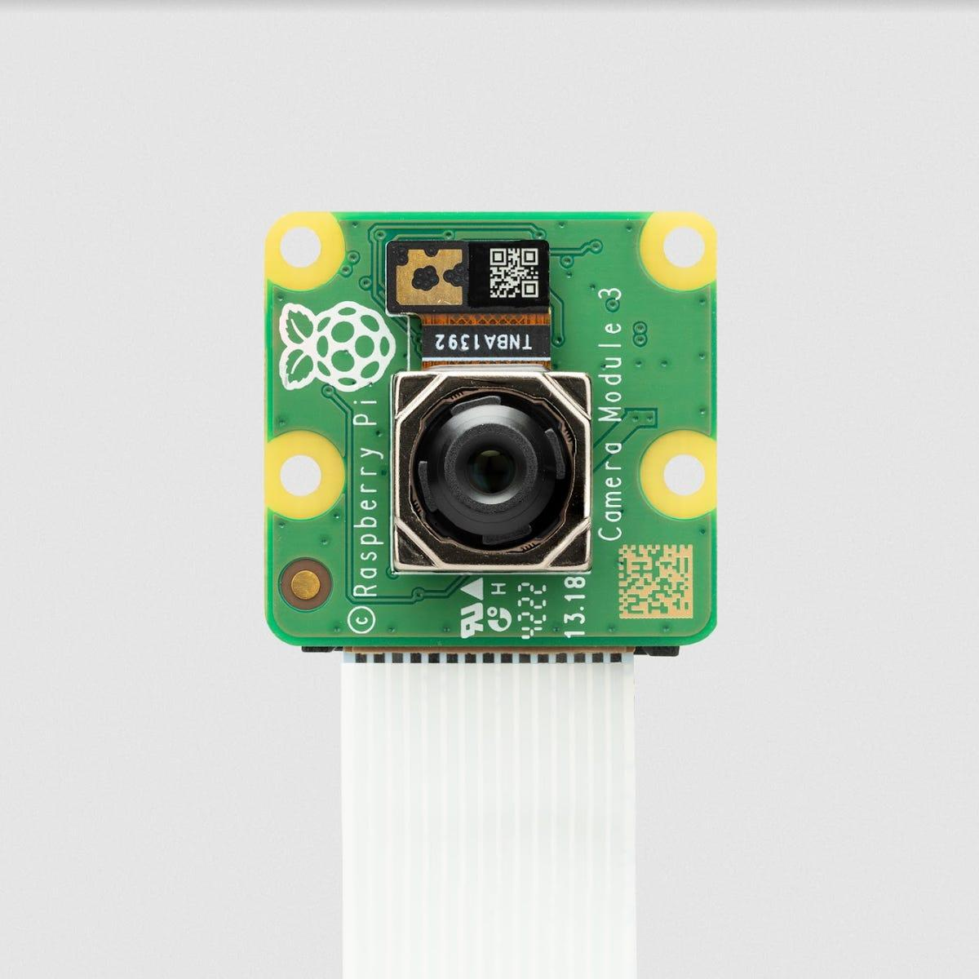
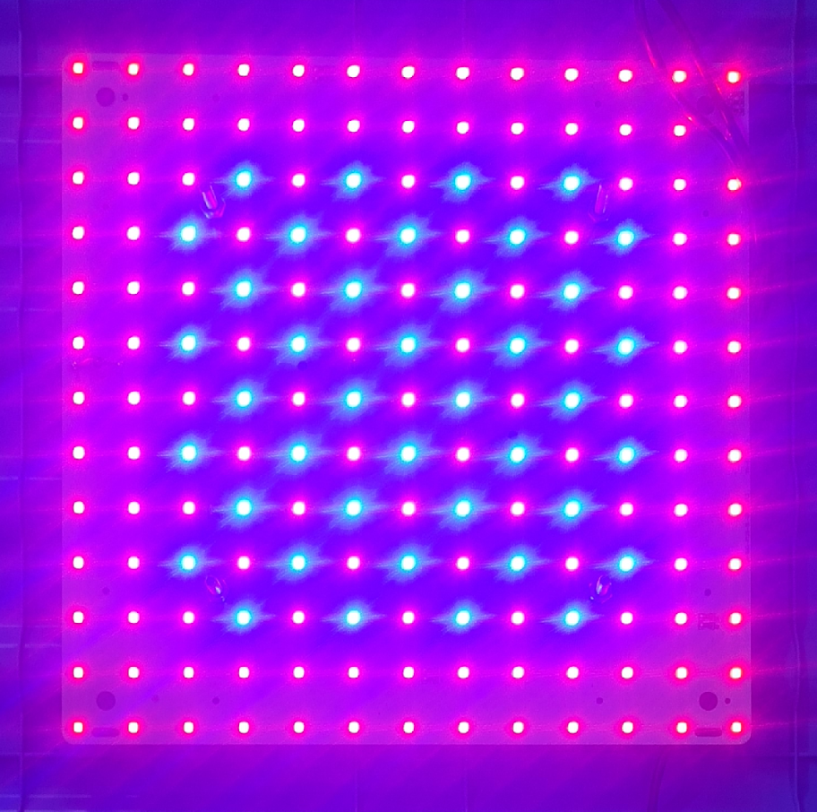
Growth Module
Fig. 3: Block diagram for the Growth Module

Slide 6
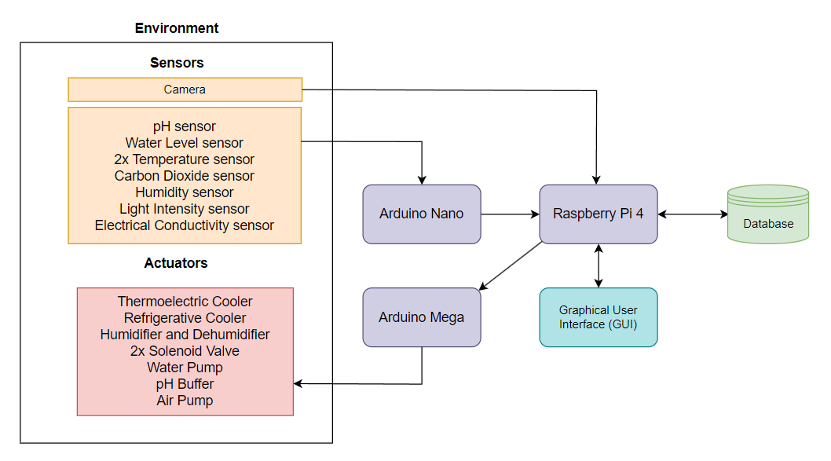
Control System
Fig. 4: Block Diagram illustrating the IoT framework running on the system

Slide 7
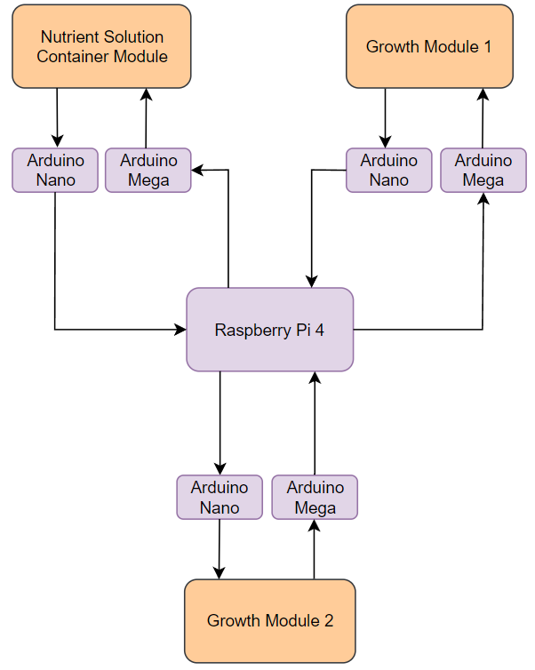
Overview for scaled system
Fig. 5: Block diagram for communication between microcontrollers and the central server

Slide 8
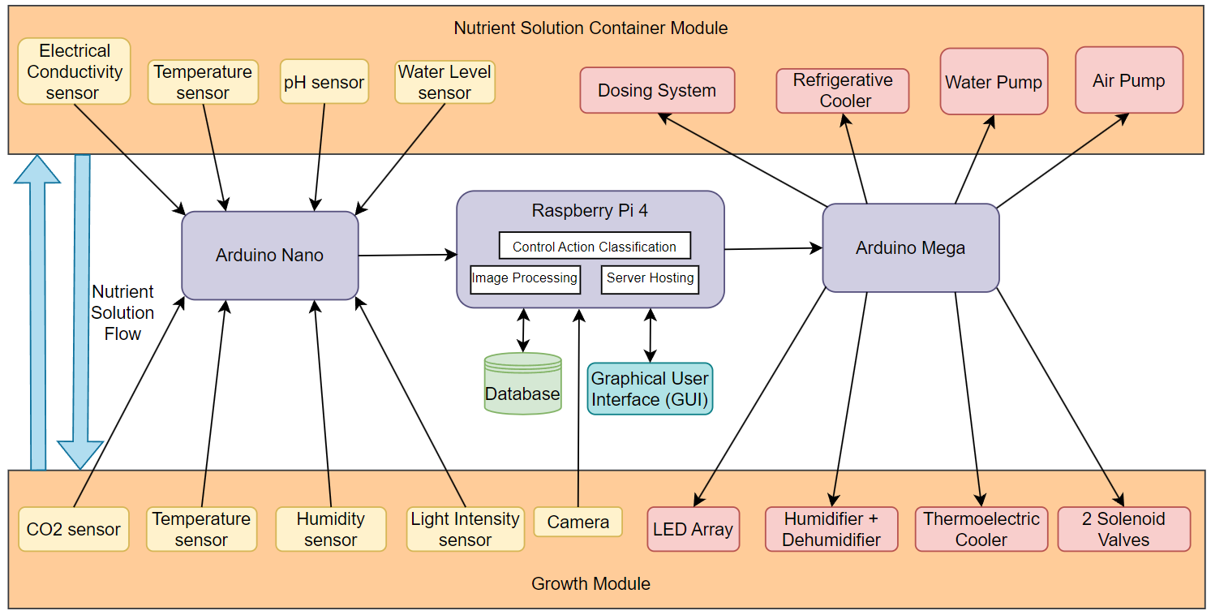
Full System Flow Diagram
Fig. 6: Complete flow diagram of the entire system illustrating the interconnections between all the components

Slide 9
Work Done Thus Far

Slide 10
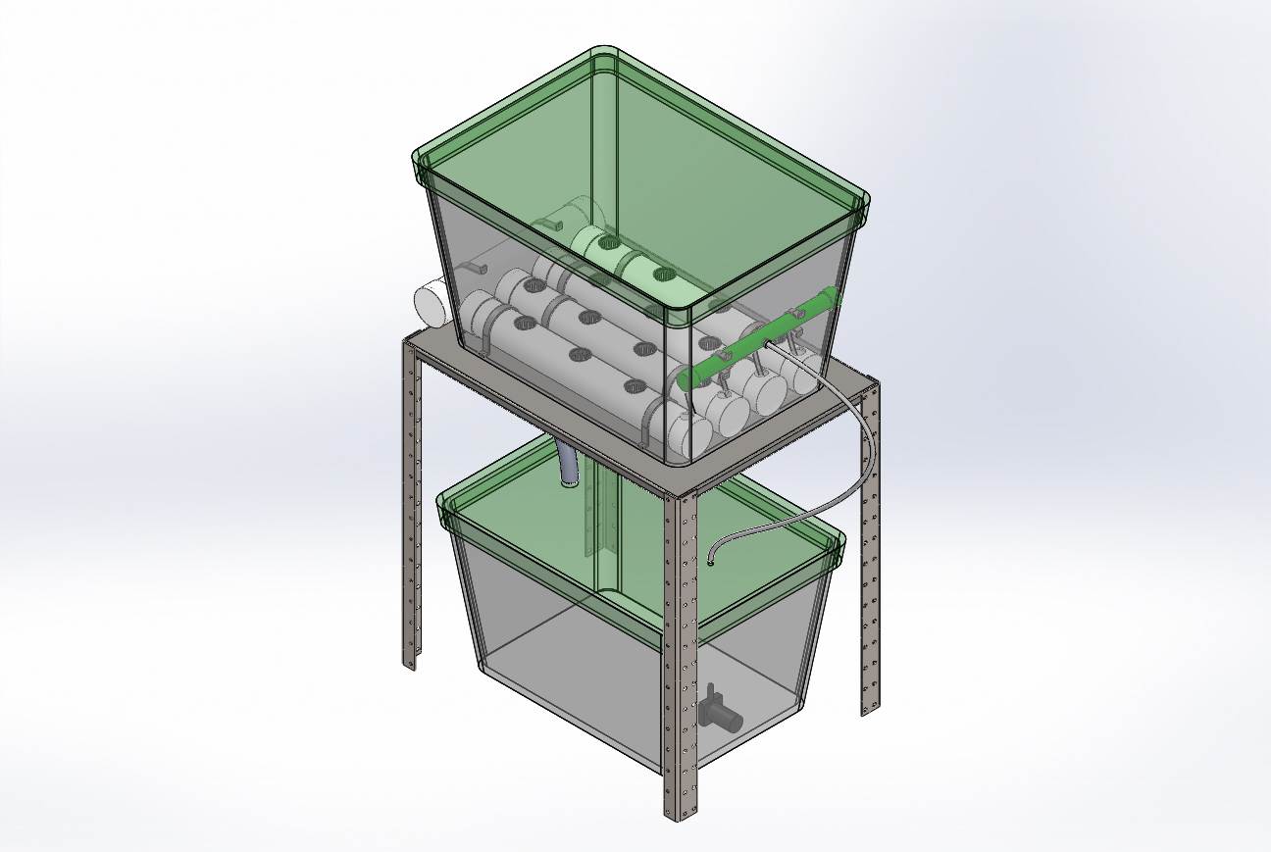
3D CAD Model
Fig. 7: Overhead view of the model.

Slide 11
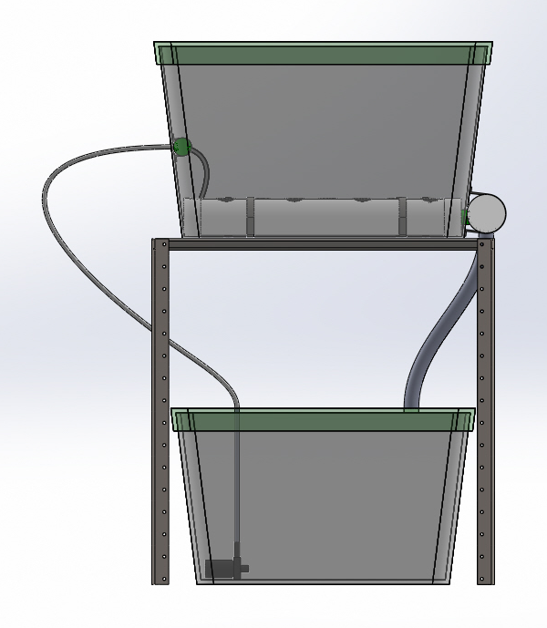
3D CAD Model
½ inch silicone tube
Growth Module
1.25 inch Hose pipe
1.25 inch Hose pipe
Nutrient Solution Container Module
Submersible Water Pump
Fig. 8: Front view of the model.

Slide 12
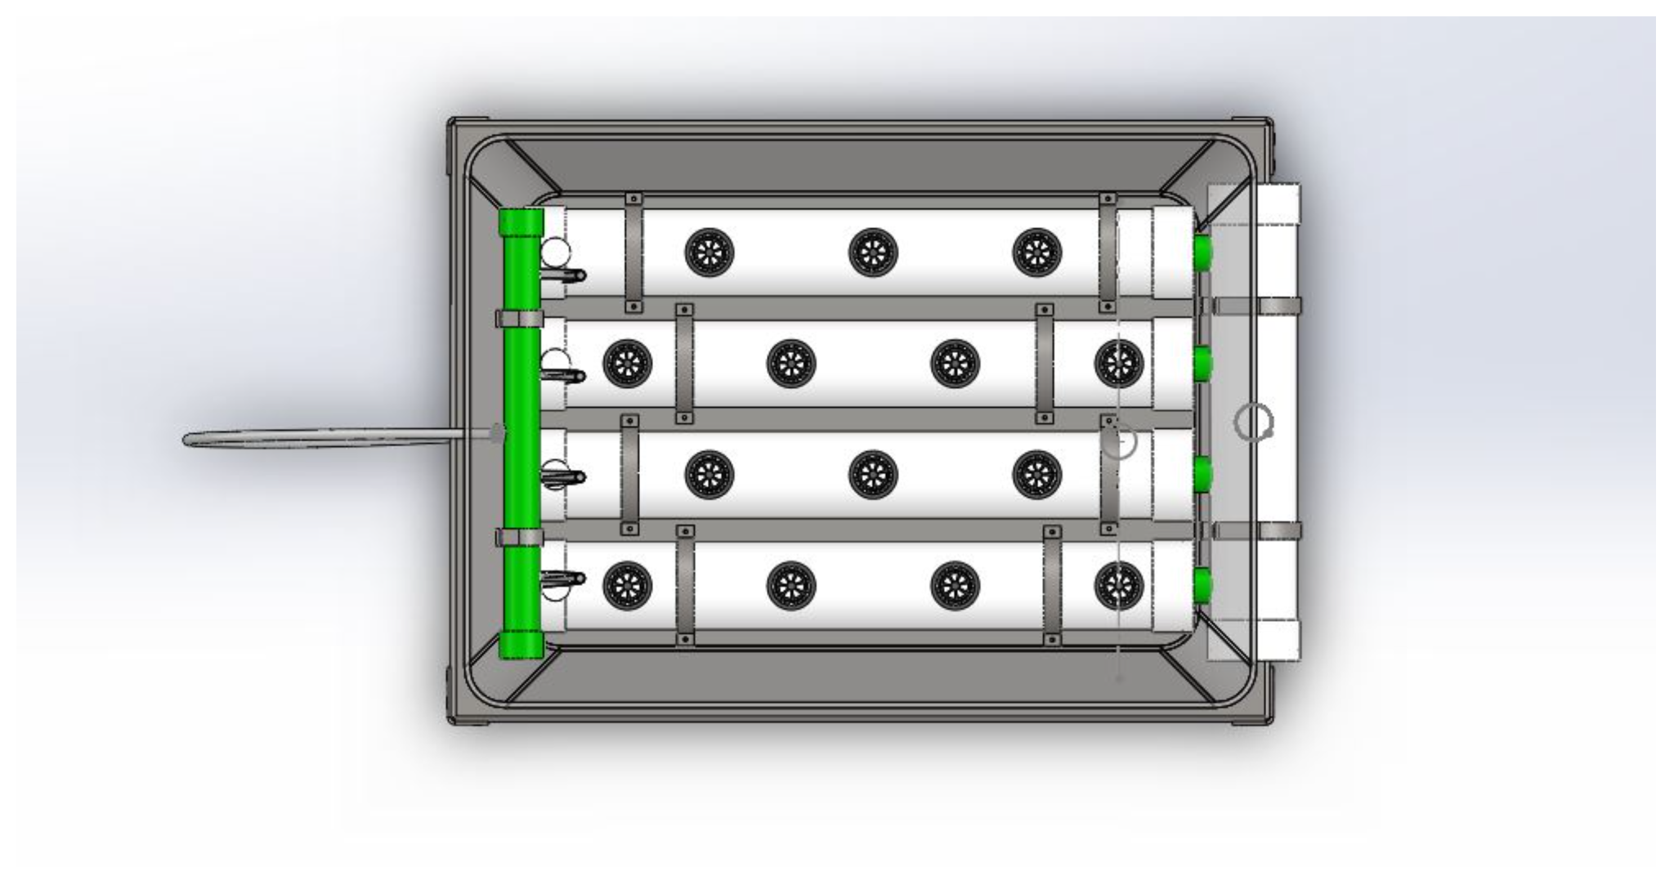
3D CAD Model
3 inch uPVC pipe to house the plants
1 inch uPVC pipe
Net pot
3 inch uPVC pipe to drain nutrient solution
Bracket
Fig. 9: Top view of the model.

Slide 13
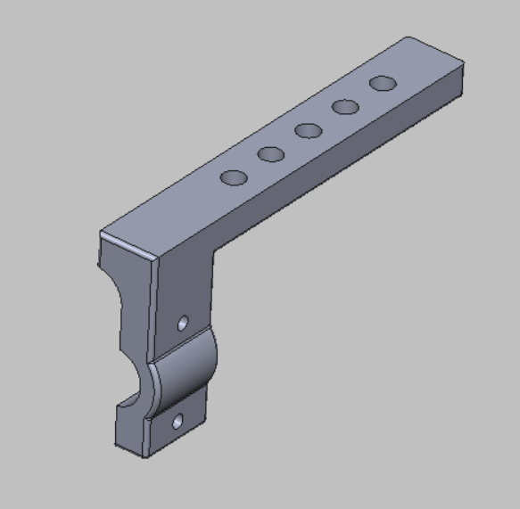
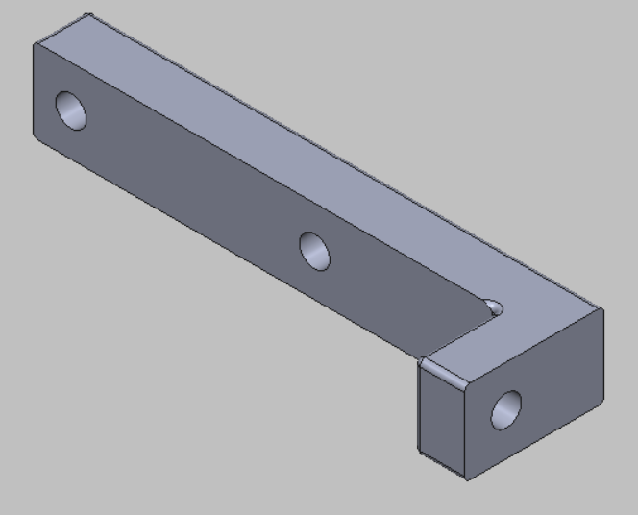
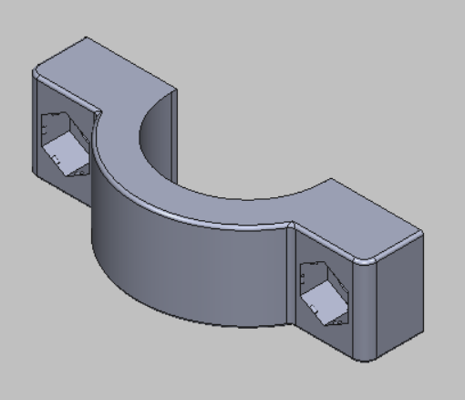
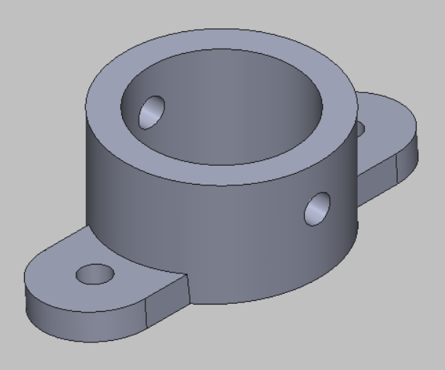
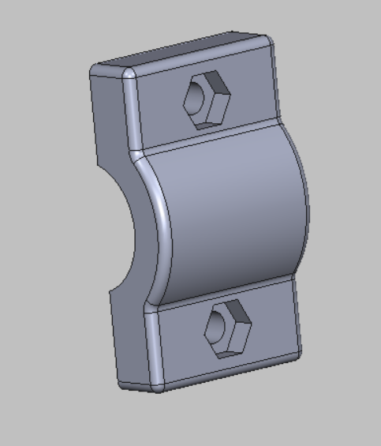
3D CAD Model
Fig. 10: Sensor holder 3D models.

Slide 14
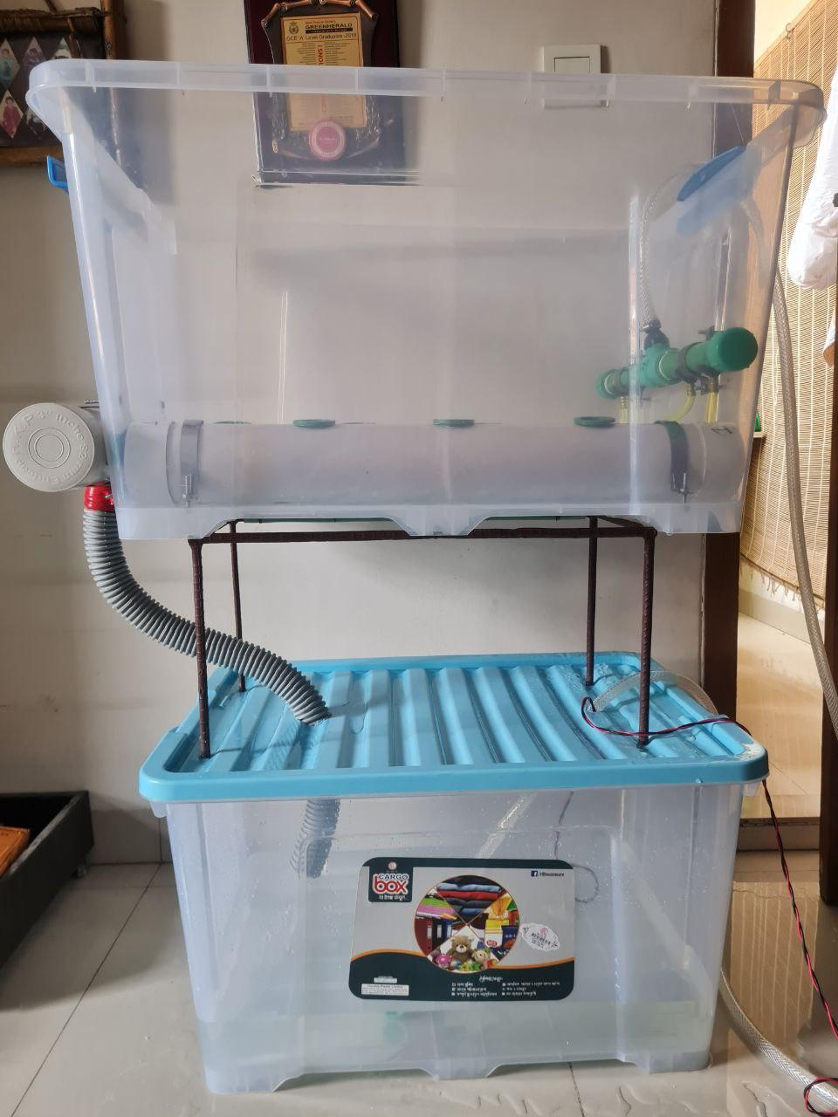
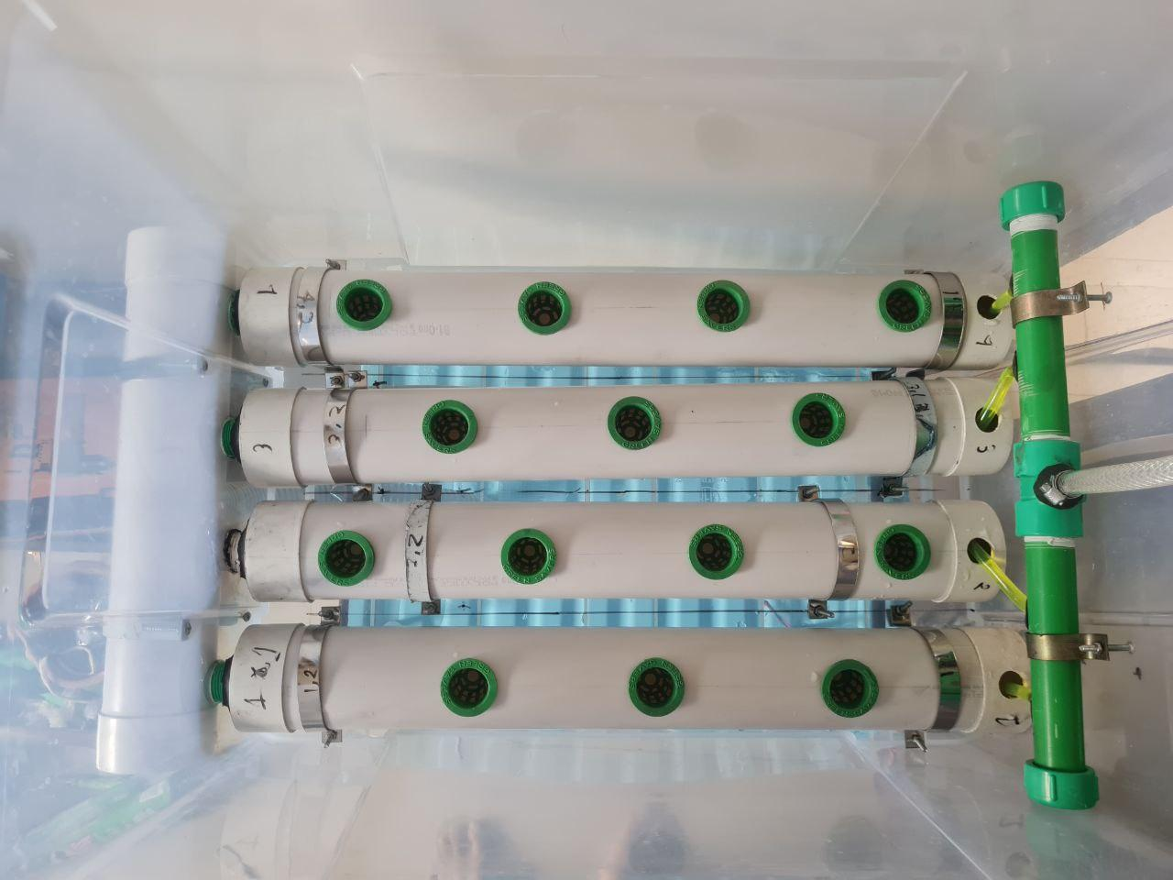
Physical Implementation (Previous)
Fig. 11: Front view of the system
Fig. 12: Top view of the system

Slide 15
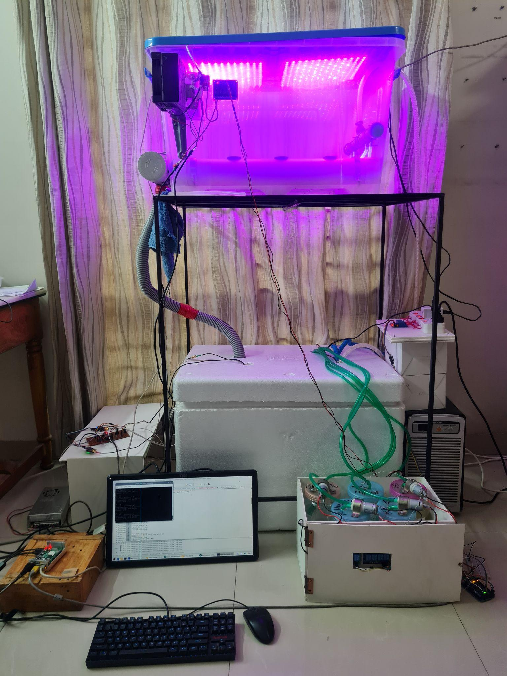
Physical Implementation (Current)
Fig. 13: Front view of the system with Grow Lights turned on

Slide 16
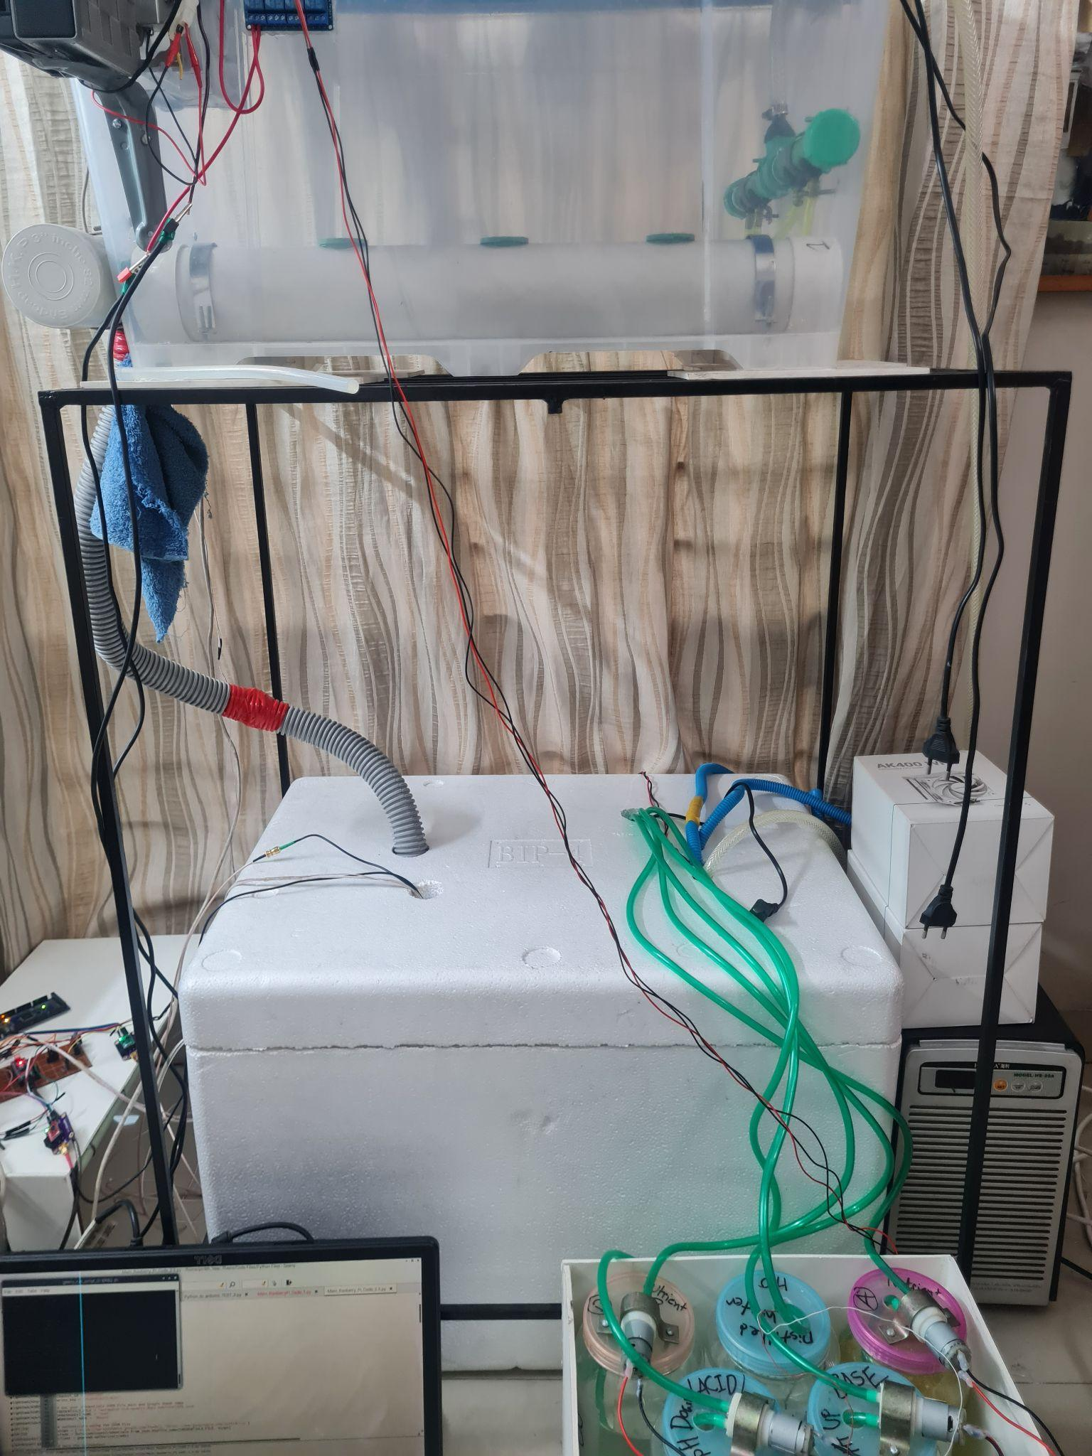
Physical Implementation (Current)
Customized
Metal Frame
Fig. 14: Front view of the system

Slide 17
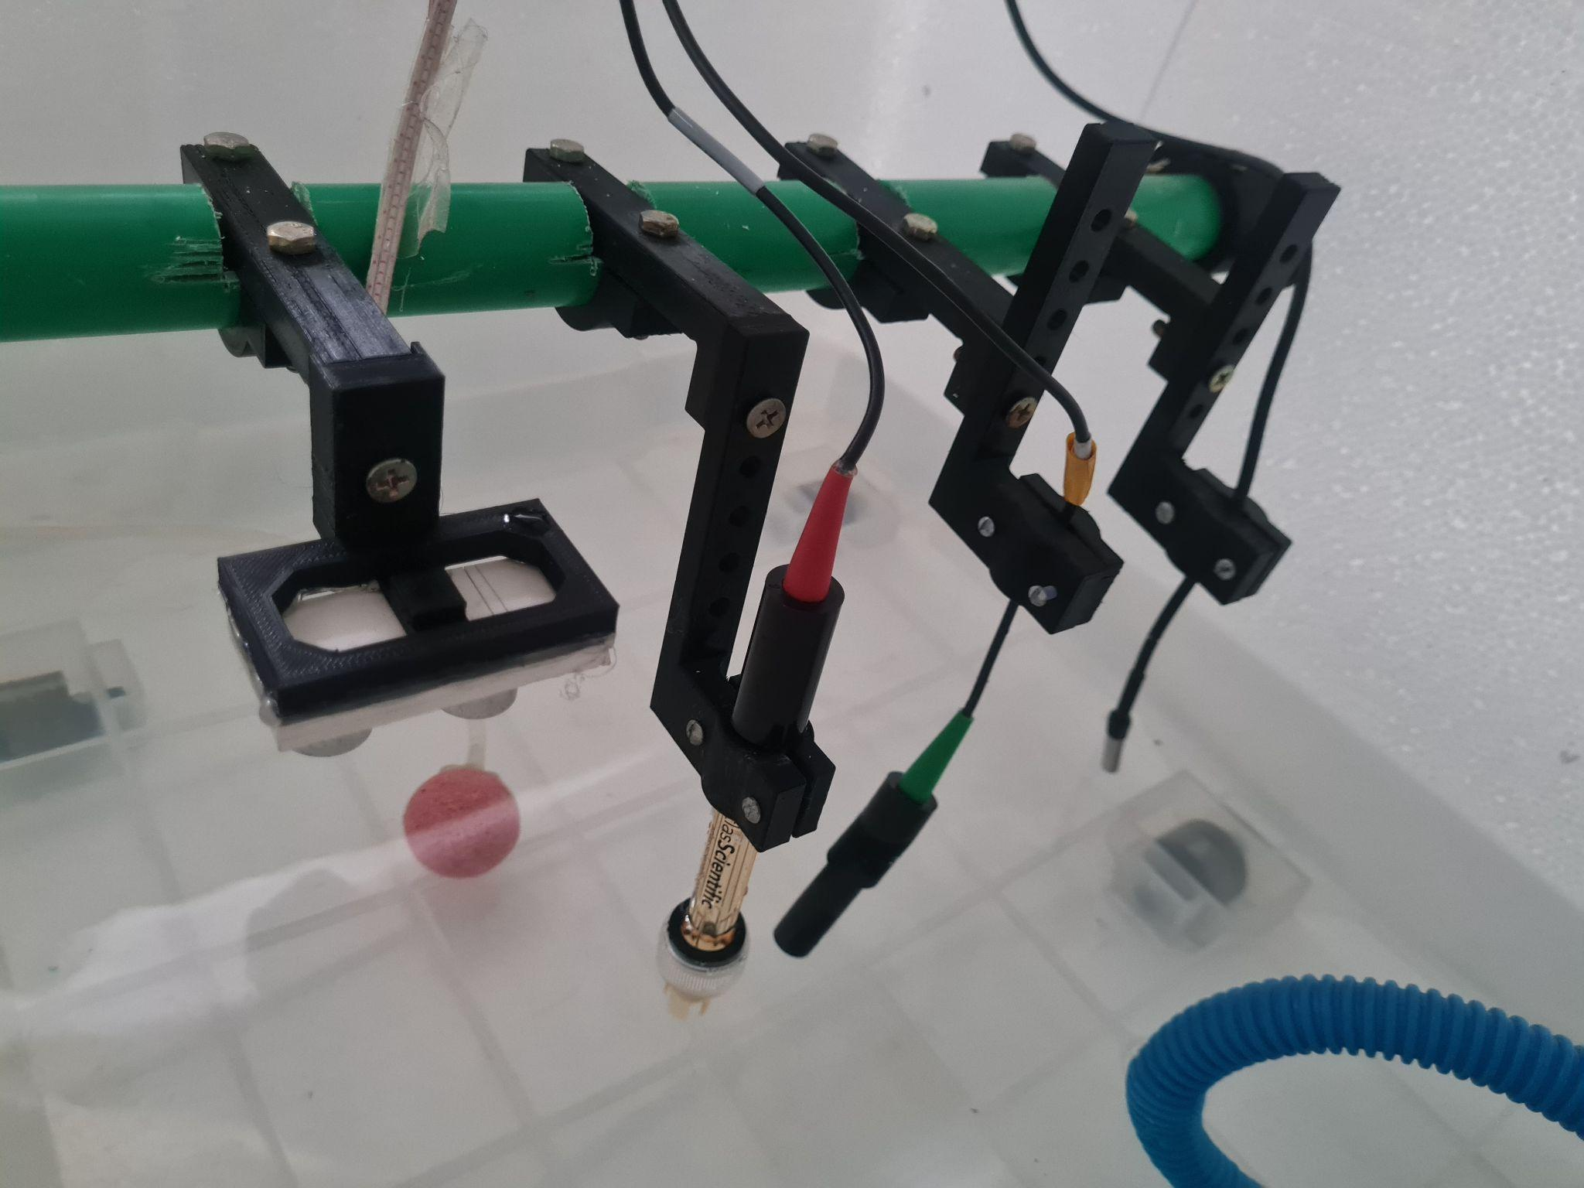
Physical Implementation
Sensor Holders
Temperature
Probe
Ultrasonic
Sensor
pH
Probe
EC Probe
Fig. 15: Ultrasonic sensor, pH probe, EC probe and temperature probe held above the nutrient solution by the sensor holders

Slide 18
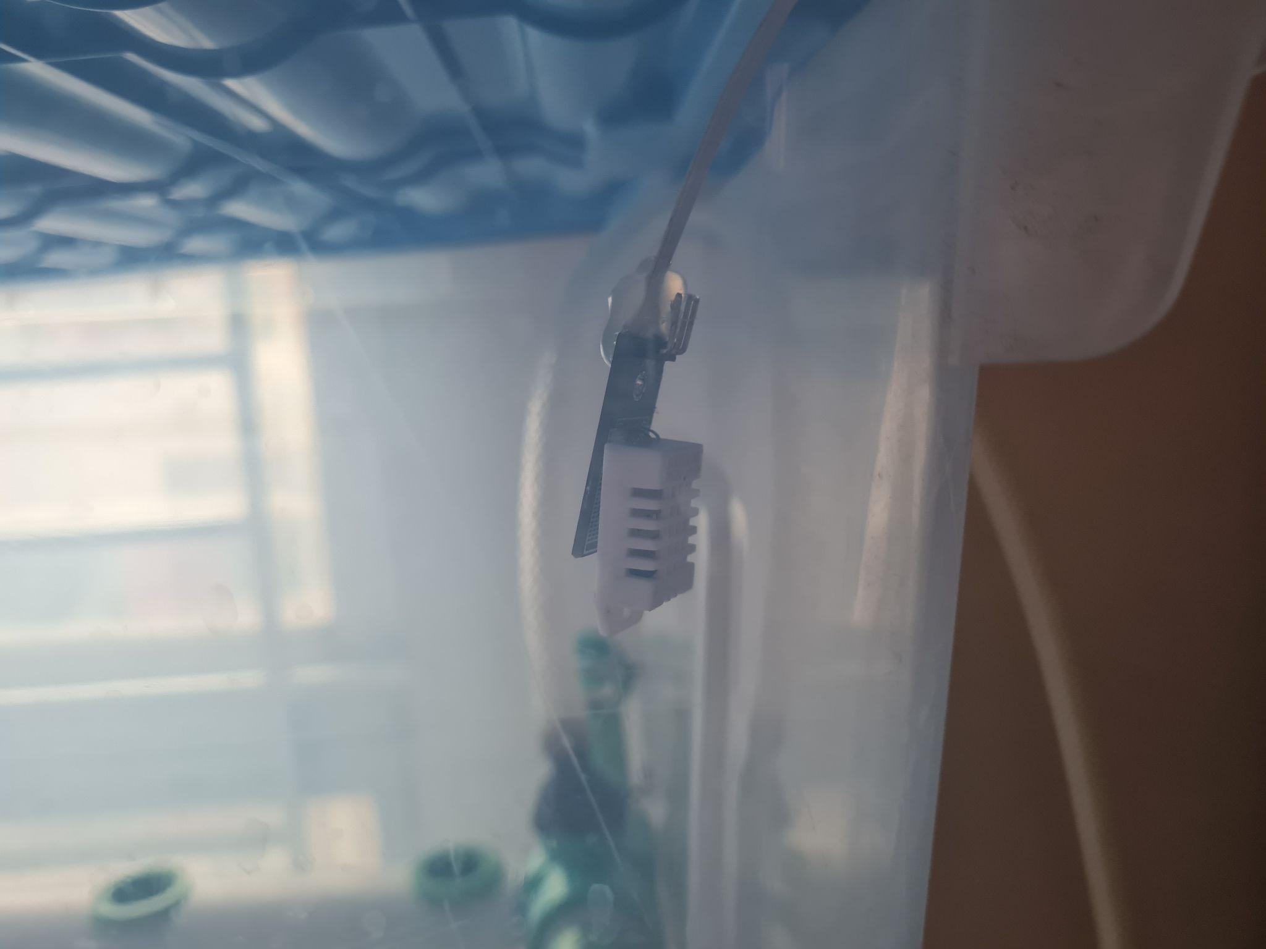
Physical Implementation
Fig. 16: Temperature and Humidity Sensor (DHT22) in the Growth Module

Slide 19
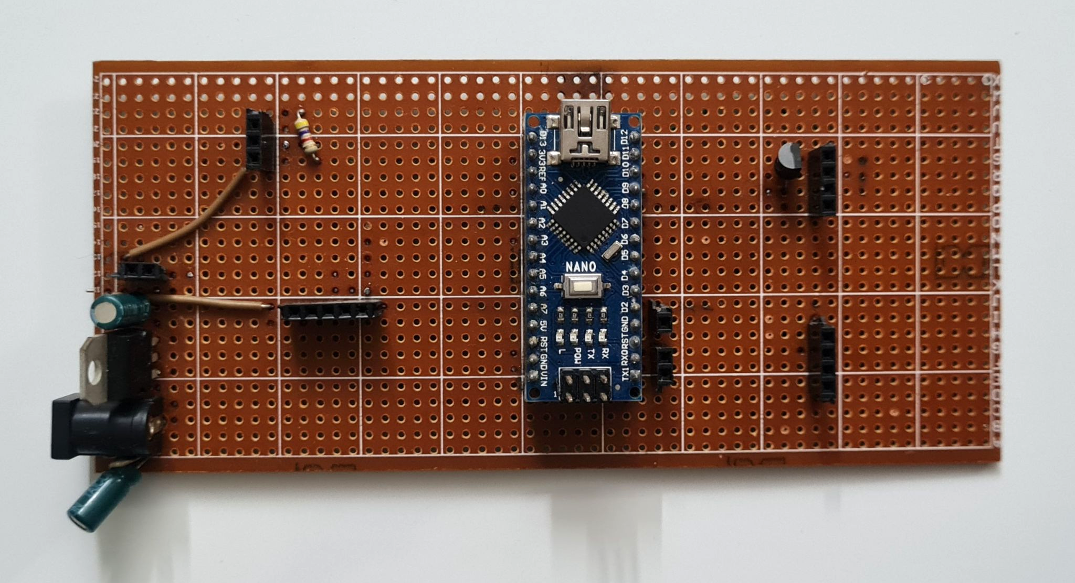
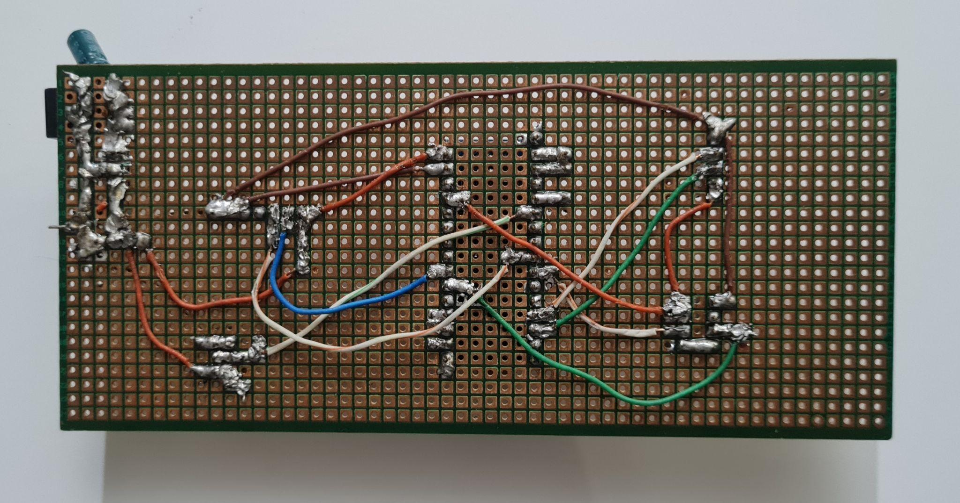
Sensor Reading
Fig. 17.1: Top view of the sensor board
Fig. 17.2: Bottom view of the sensor board

Slide 20
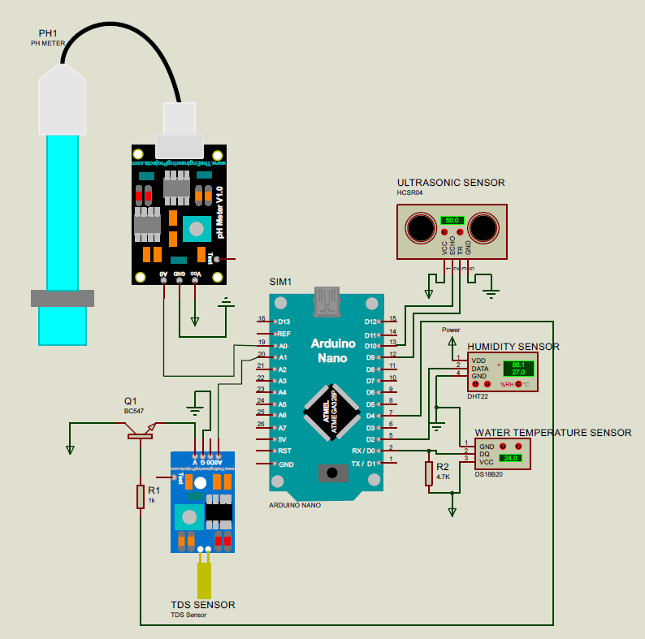
Sensor Reading
Fig. 18: Schematic for the sensor board, designed in Proteus 8 Professional

Slide 21
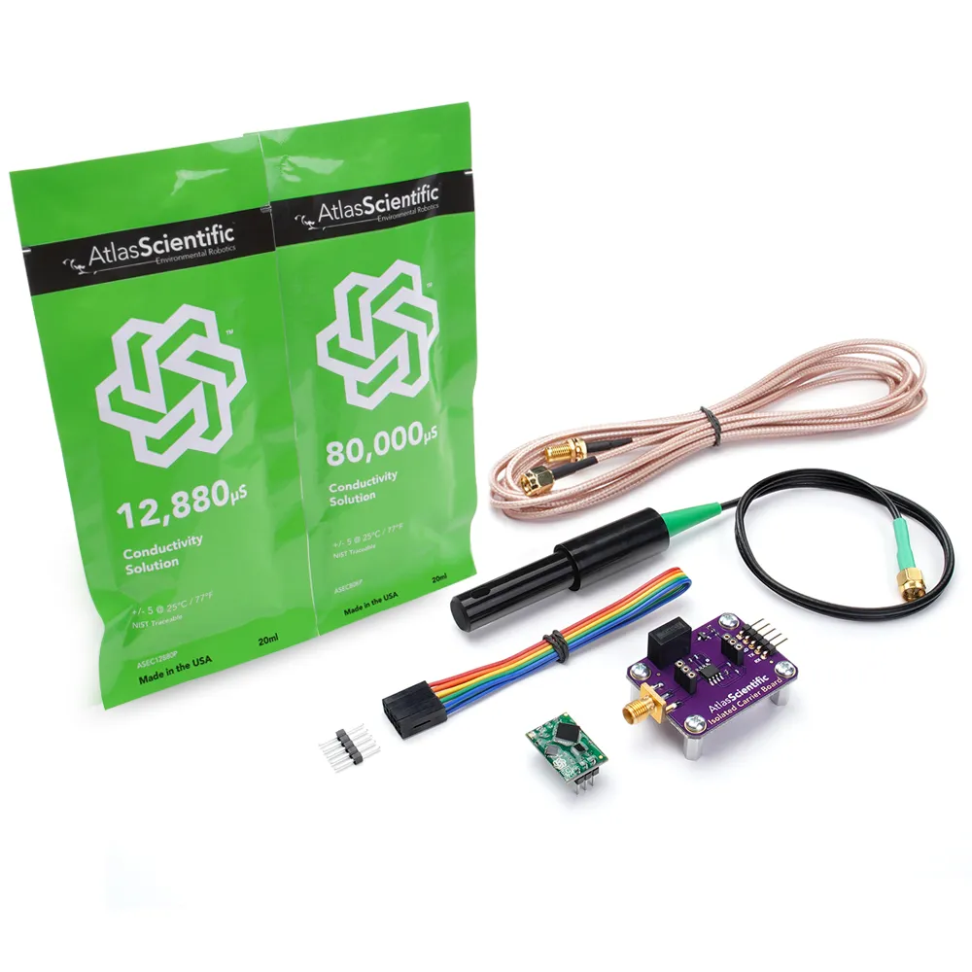
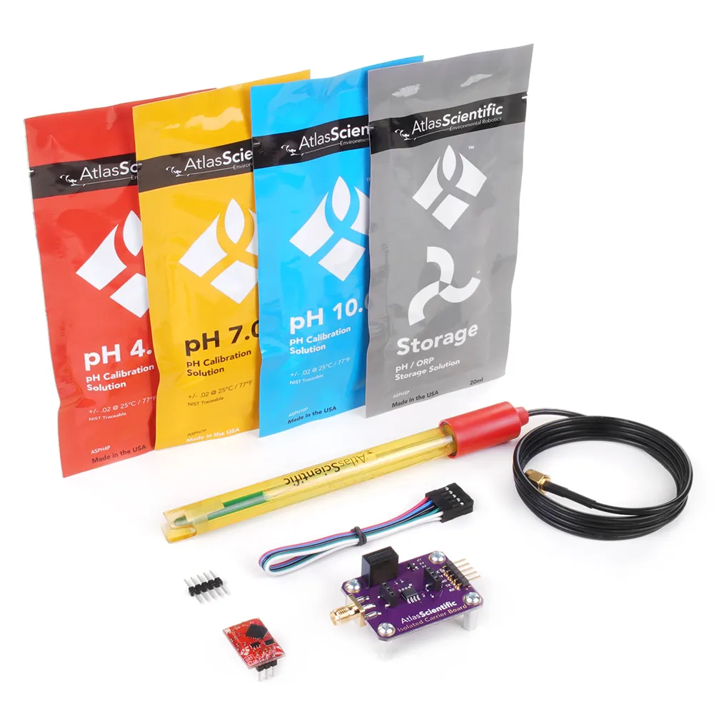
Analog Sensors
Fig. 19: Atlas Scientific pH Kit
Fig. 20: Atlas Scientific Conductivity K 1.0 Kit

Slide 22
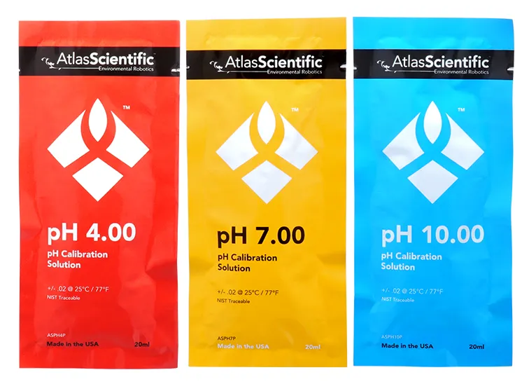
Calibrating Sensors (pH sensor)
Fig. 21: Atlas Scientific pH buffer solutions at pH 4.00, 7.00 and 10.00

Slide 23
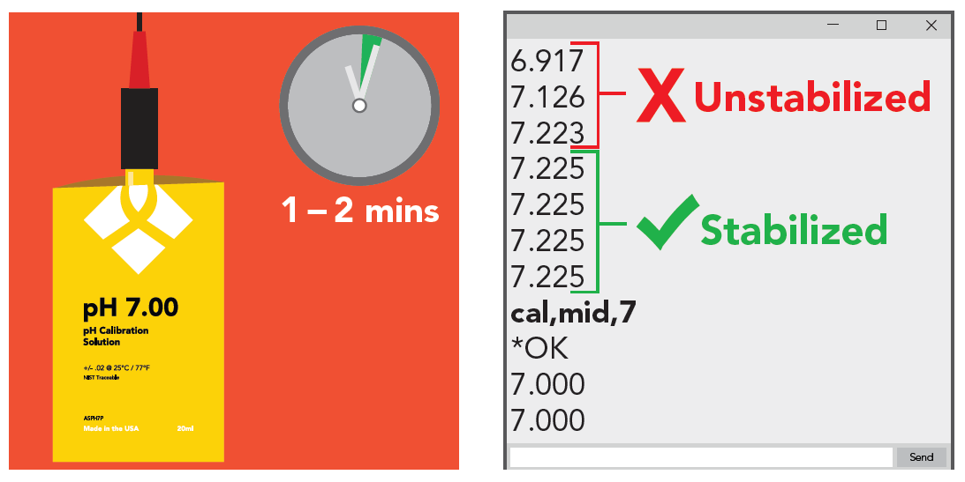
Calibrating Sensors (pH sensor)
Fig. 22: Mid Point Calibration for the pH probe

Slide 24
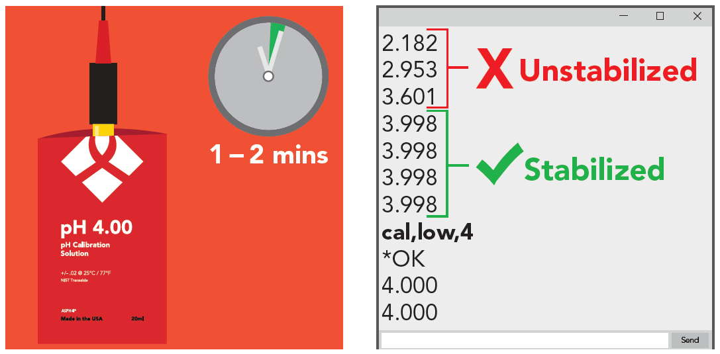
Calibrating Sensors (pH sensor)
Fig. 23: Low Point Calibration for the pH probe

Slide 25
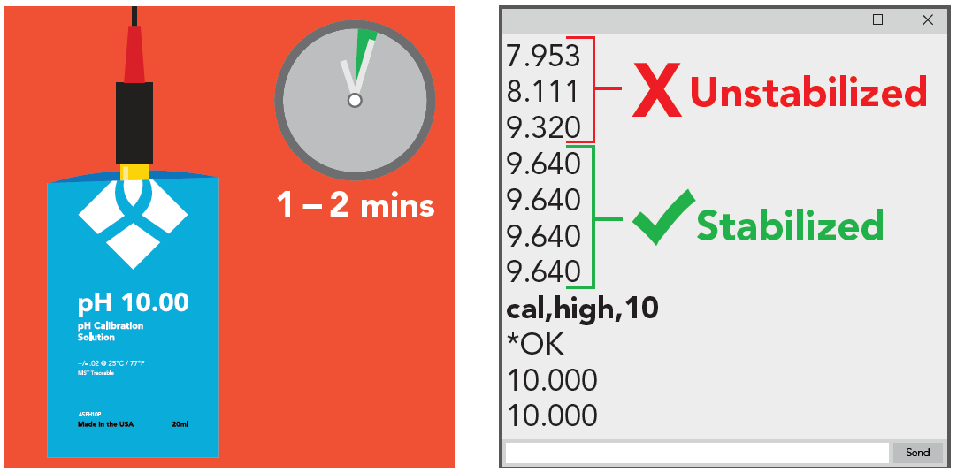
Calibrating Sensors (pH sensor)
Fig. 24: High Point Calibration for the pH probe

Slide 26
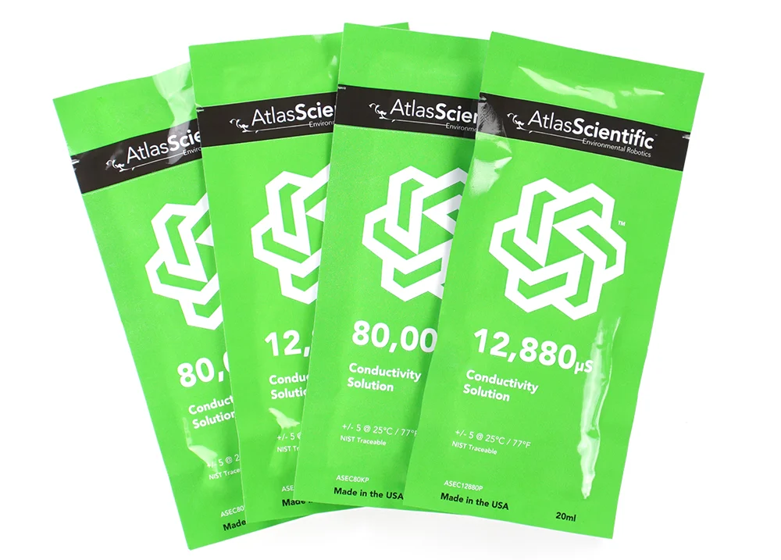
Calibrating Sensors (EC sensor)
Fig. 25: Atlas Scientific EC buffer solutions at 12,880 and 80,000 microSemens

Slide 27
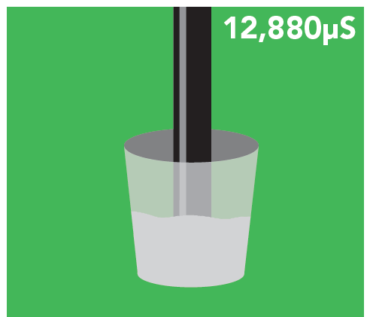
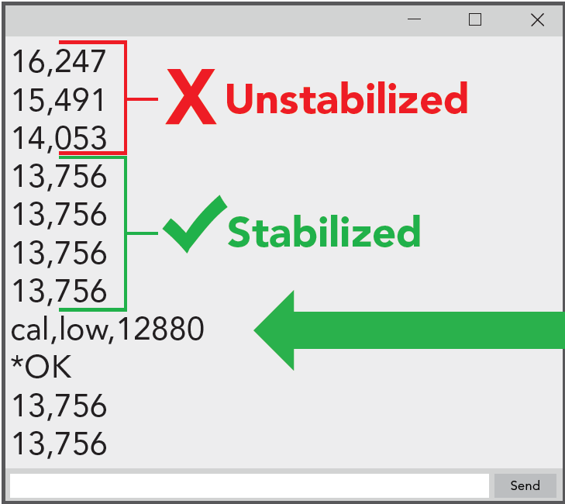
Calibrating Sensors (EC sensor)
Fig. 26: Low Point Calibration for EC probe

Slide 28
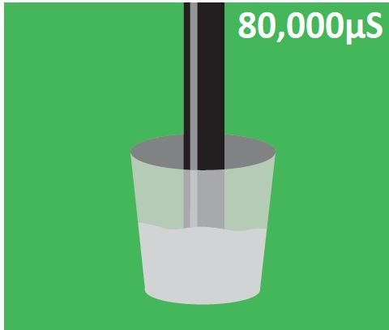
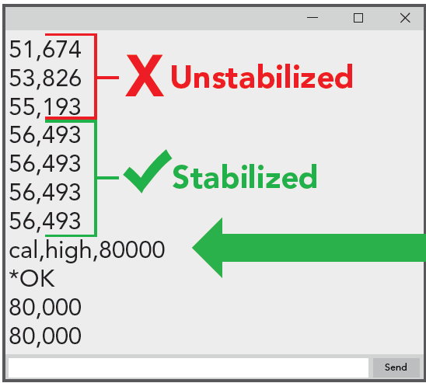
Calibrating Sensors (EC sensor)
Fig. 27: High Point Calibration for EC probe

Slide 29
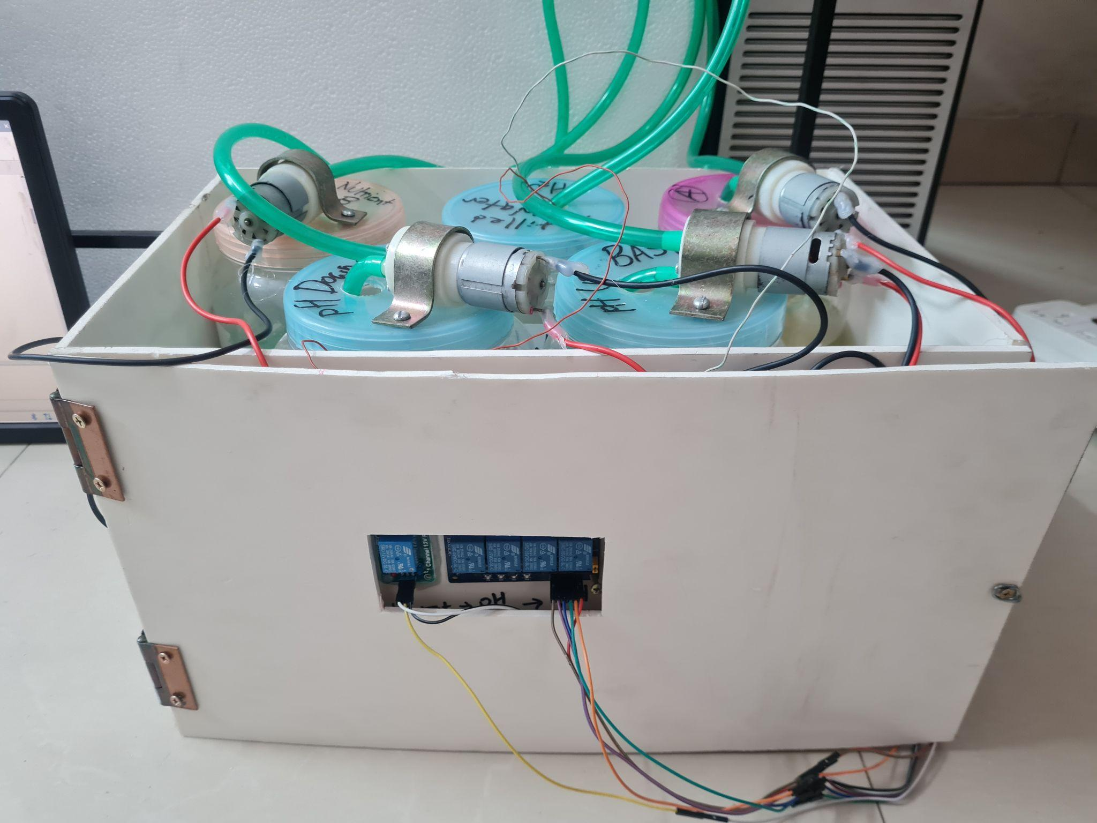
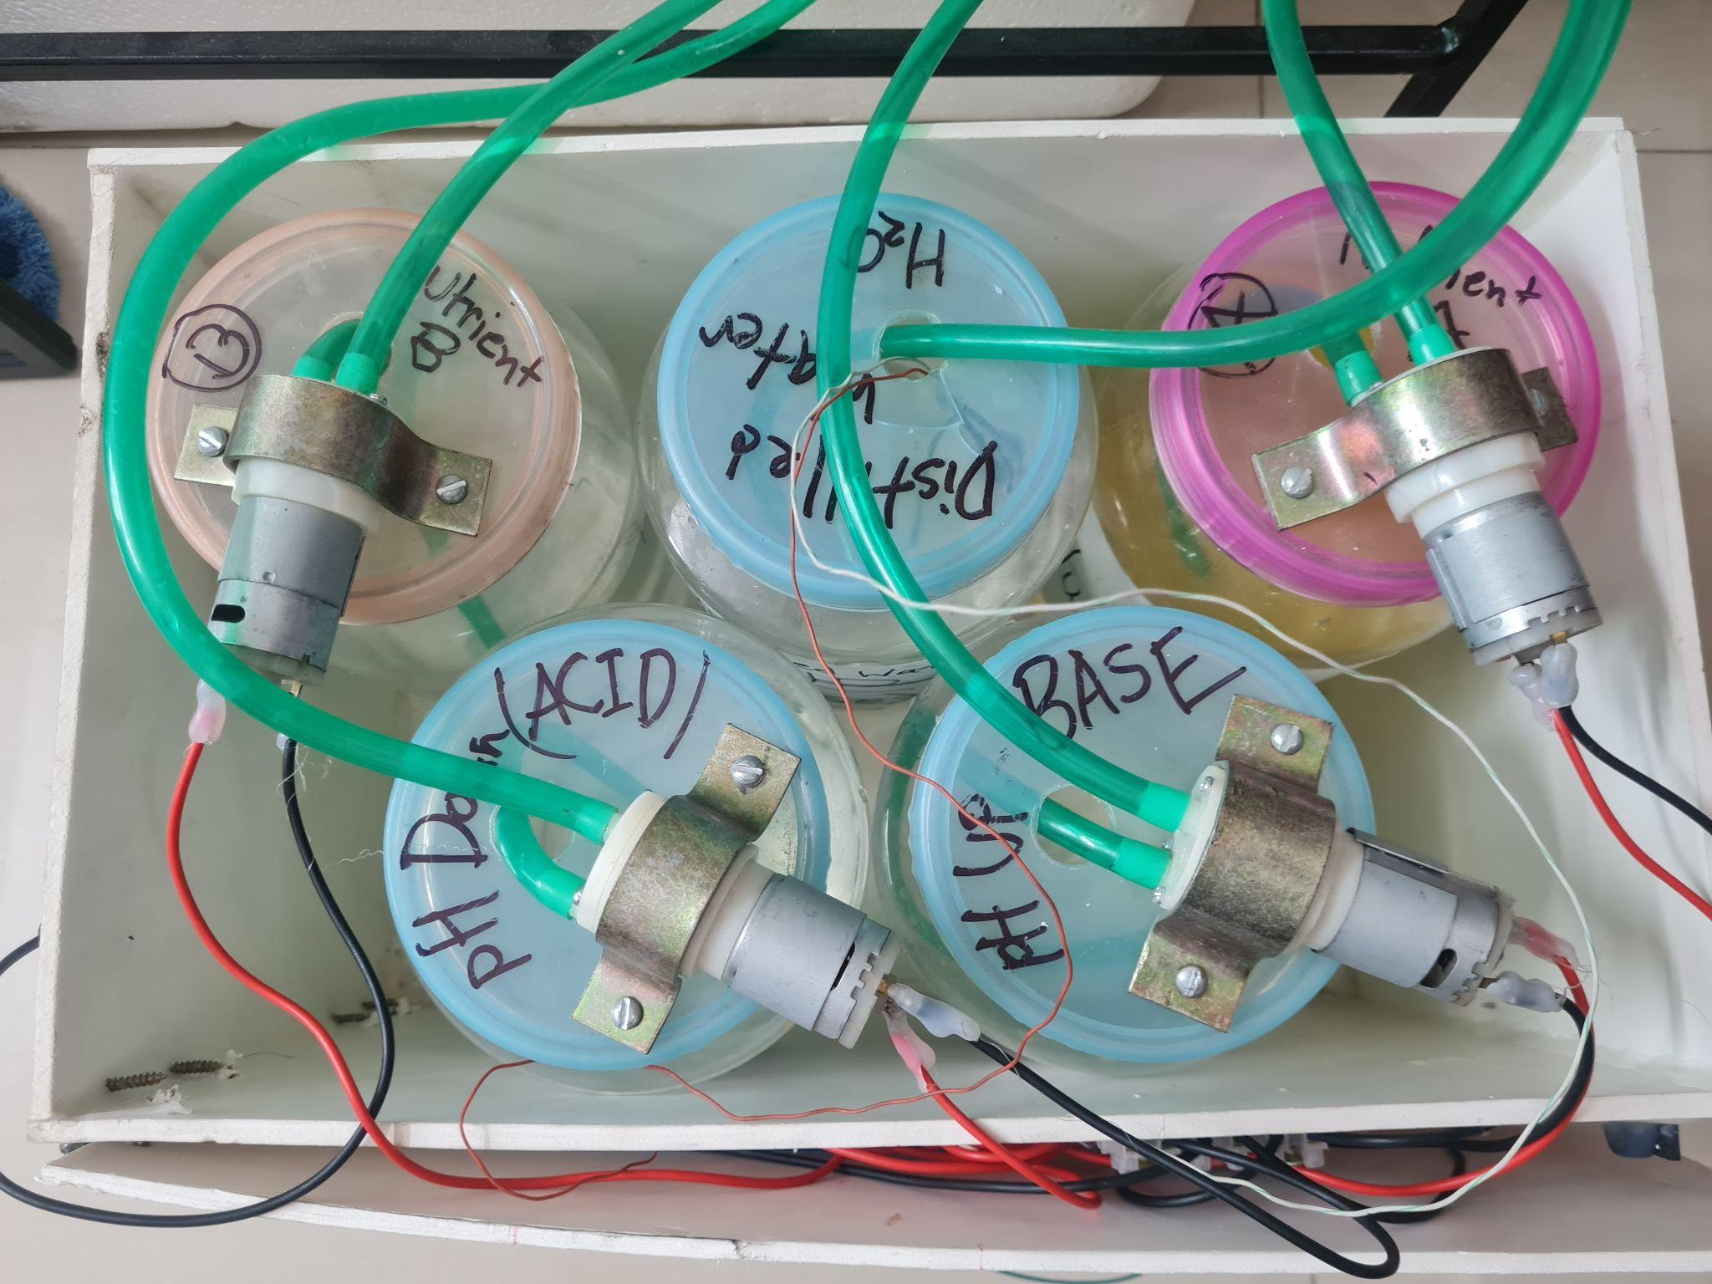
Regulating pH and Nutrient Level (EC) (Current Approach)
Fig. 28: Front View of Acid/Base and Nutrient Dosing System
Fig. 29: Top View of Acid/Base and Nutrient Dosing System

Slide 30

Regulating pH and Nutrient Level (EC) (Previous Approach)
Vaccum Pump
Submersible
Water Pump
Fig. 30: Front View of Old Dosing System
Fig. 31: Top View of the new Acid/Base and Nutrient Dosing System

Slide 31

Control Unit
Sensor
Board
Raspberry Pi 4
Arduino Mega for Actuation
Fig. 32: Control Unit showing the connections between the Raspberry Pi, the Arduino Mega and Arduino Nano

Slide 32

Growth Module
Grow Lights
Fig. 33: Top view of Grow Lights bolted on the underside of the lid

Slide 33

Regulating Water Temperature (Old)
Aluminium Water Block
Peltier Module
Cold Water Flow Out
Warm Water Flow In
Heat Sink
Fig. 34: Top view of Thermoelectric Peltier Module-based Water Cooler
Cooling Fan

Slide 34


Regulating Water Temperature
Hailea HS-28A
Aquarium Chiller
Water Pump
For Chiller
Fig. 35: Hailea HS-28A Aquarium Chiller
Fig. 36: Water Pump for Chiller

Slide 35
Regulating Water Temperature
Fig. 37: Concede Box Containing the Nutrient Container Module

Slide 36


Regulating Air Temperature
CPU Cooler
Connector
Board
Peltier Module
Fig. 38.1: Isometric view of Air Cooling System
Fig. 38.2: Top view of Air Cooling System

Slide 37

Automated AC Power Supply
Grow Lights
Water Chiller
Water Pump for Chiller
Fig. 39: Automated Multiplug using a 4-channel 12V relay

Slide 38

DC Power Supply
Peltier Module
Connection
Fig 40: Switched-Mode Power Supply (SMPS) 12V - 30A Power Supply

Slide 39


Monitoring Sensor Reading
Fig. 41: Web-based dashboard showing the visualizations from ThingSpeak from sensor data logged by the Raspberry Pi
Fig. 42: Web-based dashboard showing the widgets from ThingSpeak from sensor data logged by the Raspberry Pi

Slide 40

Collecting Data
Fig. 43: Sensor data logged by the Raspberry Pi being stored in Google Sheets

Slide 41

Decision Making Flowchart
Fig. 44: Flowchart of sensor system.

Slide 51

Our System Thus Far
Fig. 45: Front view of our system

Slide 52
Experimental Demonstration of the System

Slide 53
Results

Slide 54


Result (Testing the pH sensor)
Fig. 46: Serial Monitor readings from testing the pH sensor
Fig. 47: pH 6.86 buffer solution

Slide 55


Result (Testing the EC sensor)
Fig. 48: Serial Monitor readings from testing the EC sensor
Fig. 49: EC buffer solution of 1413 micro-siemens/cm

Slide 56

Initial Data from the System
Fig. 50: Visualizations from the sensor data collected by the Raspberry Pi at system startup

Slide 57
Initial Data from the System
Fig. 51: Updated Values from the sensor data collected by the Raspberry Pi at system startup

Slide 58
Data from the System after an interval
Fig. 52: Visualizations from the sensor data collected by the system after a time interval

Slide 59

Data from the System after an interval
Fig. 53: Update Values from the sensor data collected by the Raspberry Pi after a time interval

Slide 60
Google Sheet Spreadsheet updates
Fig. 54: The Google Sheet spreadsheet showing the sensor data logged by the Raspberry Pi since system startup

Slide 61

Result
Fig. 55: Serial Monitor readings from testing the sensors.
Table 1: Serial Monitor readings from testing the sensors.

Slide 62
Economic Viability

Slide 63




Fig. 56: Total expenditure thus far behind the system

Slide 64

Fixed Costs for the Modules
Fig. 57: Fixed costs behind the components used in each module

Slide 65

Average Cost over time with 1 Growth Module
Fig. 58: Average cost vs Production cycle graph using 1 Growth Module

Slide 66

Average Cost over time with 2 Growth Modules
Fig. 59: Average cost vs Production cycle graph using 2 Growth Module

Slide 67

Average Cost over time with 4 Growth Module
Fig. 60: Average cost vs Production cycle graph using 4 Growth Module

Slide 68
Expected Work To Be Done

Slide 69
Future Improvements
Exploring more cost-effective materials for building the modules
Improving airflow within a small-scale system
Controlling humidity effectively within a small-scale system
Testing a larger variety of plants to test all-round efficacy
Analysing the nutritional contents of the produce

Slide 70

Project Timeline
Fig. 70: Timeline for the different stages of the project

Slide 71
Conclusion

Slide 72
Conclusion
The system can now fully control all the growth parameters autonomously
System can be monitored remotely and plants viewed from video feed
XGBoost Classifier outperforms previous works; similar performance to if-else conditional programming
System scalability demonstrated along with predictions for greater scaling and lower Average Cost
With additional work, this system can push forward a new narrative in the agrarian landscape

Slide 73
References
[1] Gericke, William F. (1937). "Hydroponics - crop production in liquid culture media". Science. 85 (2198): 177– 178. [2] Macrovector, Hydroponics Farming Concept,[Online], Available: https://www.vectorstock.com/royalty-free-vector/hydroponics-farming-concept-vector-27183466 [3] iStock, Young seedling of vegetable grows in fertile soi sprout with underground rootl, [Online], Available: https://www.istockphoto.com/vector/young-seedling-of-vegetable-grows-in-fertile-soil-sprout-with-underground-root-gm1213143822-352438337 [4] iStock, Hydroponics plants vector isolated illustration, [Online], Available: https://www.istockphoto.com/vector/hydroponics-plants-vector-isolated-illustration-gm968421950-264048421 [5] Freepik, Hydroponics benefits concept with water saving fast growth symbols, [Online], Available: https://www.freepik.com/premium-vector/hydroponics-benefits-concept-with-water-saving-fast-growth-symbols-cartoon_13768284.html [6] Lineham, Verity, Sally Thorpe, Neil Andrews, Yeon Kim, and Farah Beaini. Food Demand to 2050: Opportunities for Australian Agriculture, Algebraic Description of Agrifood Model. ABARES, 2012. [7] Palande, Vaibhav, Adam Zaheer, and Kiran George. "Fully automated hydroponic system for indoor plant growth." Procedia Computer Science 129 (2018): 482-488. [8] D. Adidrana and N. Surantha, "Hydroponic Nutrient Control System based on Internet of Things and K-Nearest Neighbors," 2019 International Conference on Computer, Control, Informatics and its Applications (IC3INA), Tangerang, Indonesia, 2019, pp. 166-171, doi: 10.1109/IC3INA48034.2019.8949585. [9] Kularbphettong, Kunyanuth, Udomlux Ampant, and Nutthaphol Kongrodj. "An automated hydroponics system based on mobile application." International Journal of Information and Education Technology 9.8 (2019): 548-552. [10] M. Mehra, S. Saxena, S. Sankaranarayanan, R. J. Tom, and M. Veeramanikan- dan, “Iot based hydroponics system using deep neural networks,” Computers and electronics in agriculture, vol. 155, pp. 473–486, 2018. [11] D. S. Domingues, H. W. Takahashi, C. A. Camara, and S. L. Nixdorf, “Automated system developed to control ph and concentration of nutrient solution evaluated in hydroponic lettuce production,” Computers and electronics in agriculture, vol. 84, pp. 53–61, 2012. [12] C. S. Dr. Melissa Brechner, Dr. A.J. Both, Hydroponic Lettuce Handbook. New York, USA: Cornell University Controlled Environment Agriculture Program, 2013.

Slide 74
Thank You

Slide 76
Smart Control Action Classification with XGBoost

Slide 77
Why XGBoost?
Gained immense popularity at Kaggle competitions
Highly sophisticated with low training times
Performs exceptionally well with tabular datasets
Efficient handling of missing data

Slide 78
Our Dataset
(Oi diagram ta add koris je ThingSpeak theke amra CSV te nitesi namaiya)

Slide 79

Our Dataset
Number of data points = 57,638
Number of Classes = 20
Dataset is imbalanced due to controlled environment
Fig. : Distribution of Class Instances in the dataset

Slide 80
Building the XGBoost Classifier
Training, Validation and Test set split = 60% : 20% : 20%
Training time = 27.440 seconds
Optimal hyperparameter values obtained:
Hyperparameter | Value
n_estimators | 100
learning_rate | 0.1
max_depth | 3
min_child_weight | 1
gamma | 0
subsample | 1
colsample_bytree | 1
reg_alpha | 0
reg_lambda | 1

Slide 81


Classification and Loss Curves
Fig. : Classification Error over Epochs trained
Fig. : Loss over Epochs trained

Slide 82
Comparison with Related Works
Model | Accuracy | Precision | Recall | F1-Score | AUC
[1] | 0.933 | Nil | Nil | Nil | Nil
[2] | 0.885 | Nil | Nil | Nil | Nil
Our Model | 1.000 | 1.000 | 1.000 | 1.000 | 0.999
Fig. : Comparison of Performance Metrics with Related Works

Slide 83

Economic Viability
For the system to become profitable, the cost of each lettuce has to be less than market price.

Slide 84
Calculating Total Fixed and Variable Costs
Type of Fixed Cost | Value (in Taka)
First Growth Module (GM) | 12,590
Second Growth Module (GM) | 10,480
Nutrient Solution Container Module | 19,030
Computing Unit | 10,950
Total Fixed Cost | 42,570
Fig. : List of fixed costs incurred by the system

Slide 85
Calculating Average Cost
Considering an estimated Tk. 500 as the Variable Cost per production cycle (~27 days)
Here, N = Number of Growth Modules (GM) C.NSCM = Cost of Nutrient Solution Container Module (NSCM) C.GM = Cost of Growth Module (GM)
T = Number of Production Cycles Run
VC = Variable Cost per Production Cycle

Slide 86

Plot of Average Cost against Production Cycles (1 GM)

Slide 87

Plot of Average Cost against Production Cycles (2 GMs)

Slide 88

Plot of Average Cost against Production Cycles (3 GMs)

Slide 89
Observation from Scaling the Number of GMs
Increasing number of GMs to 2 will lead to break even in ~19 months
Increasing number of GMs to 3 will lead to break even in less than 12 months

